Slide 1
Session-1

Slide 2
Contents:
What is Financial Statement Analysis?
Techniques of Financial Statement Analysis
Objectives of Financial Statement Analysis
Components of Financial Statement Analysis
Components of Balance Sheet
Purpose of Balance Sheet
Balance Sheet of Apple Inc- critical analysis
Components of Profit & Loss Account
Objectives of Profit & Loss Account
Profit & Loss Account of Max Electronics- Critical Analysis
Purpose of Cash Flow Statement
Real Life Cash Flow Statement of a Company
Financial Trend Analysis & Business Performance
DuPont Analysis
Extended DuPont method and ROE calculation

Slide 3
What is Financial Statement Analysis?
Financial statement analysis is the process of examining and evaluating a company's financial statements.
It involves studying financial reports such as the balance sheet, income statement, and cash flow statement.
It involves interpreting financial ratios, trends, and metrics to understand strengths, weaknesses, opportunities, and risks

Slide 6
Trading, Profit & Loss A/C
Company’s revenue, expense, Net Profit or Net Loss
Balance Sheet
Statement of Financial Position on a particular day and the components are Asset, Liabilities and Net-worth
Cash Flow Statement
A cash flow statement is a financial statement that provides information about the cash inflows and outflows.
It has 3 Components-
(i) Cash flow from Operating activity,
(ii) Cash flow from Investing activity
(iii) Cash Flow from Financing activity
It is structured into two components- Trading Account, Profit & Loss Account

Slide 7
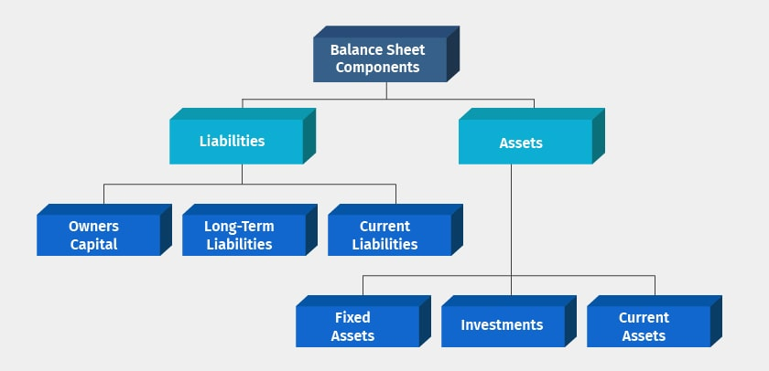

Slide 9
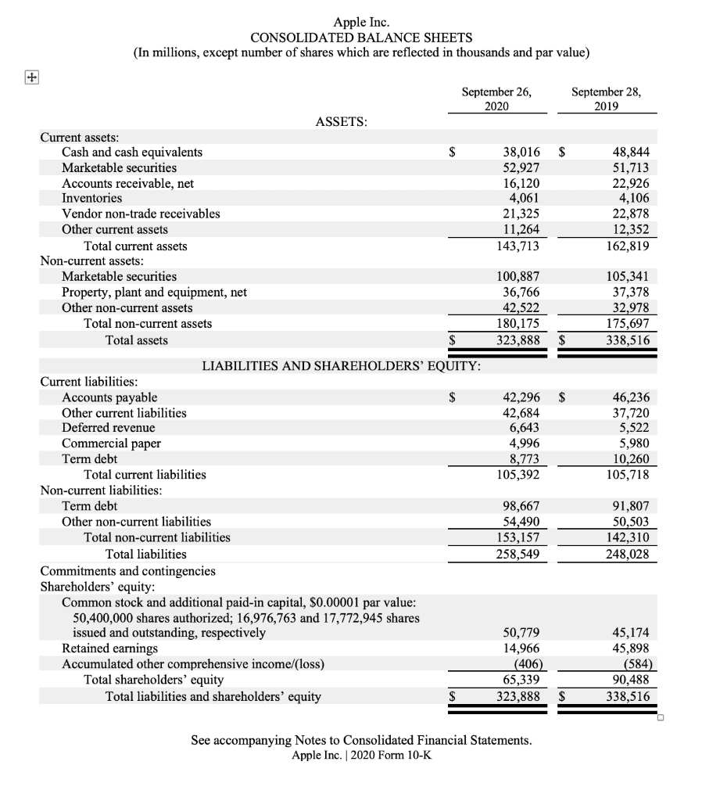

Slide 10
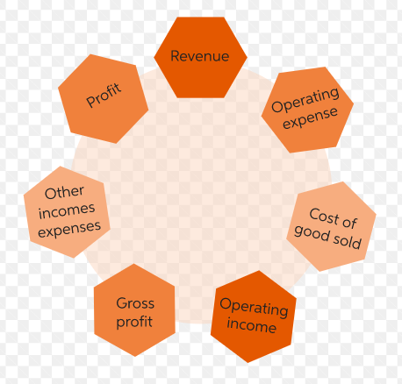
Components of Profit & Loss A/C

Slide 11
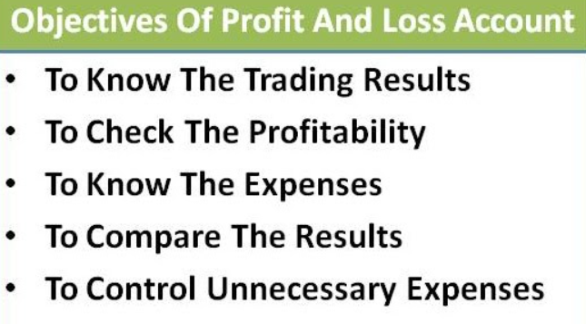

Slide 12
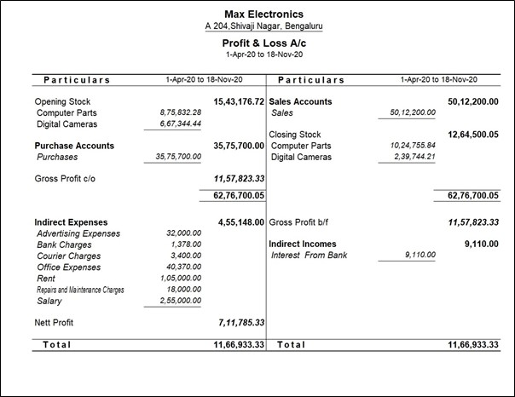

Slide 13
When a company repurchases its own shares and holds them as treasury stock, it typically involves a cash outflow.

Slide 14
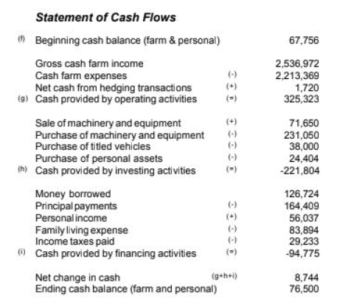

Slide 19
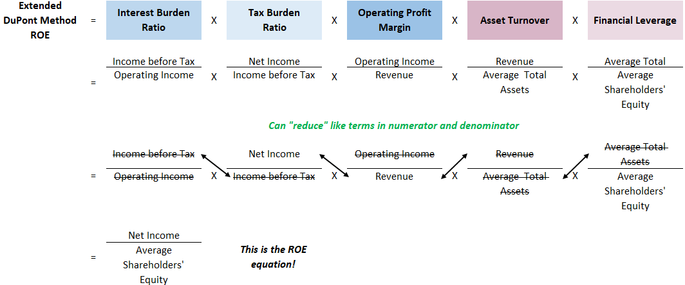

Slide 20
THANK YOU

