Slide 1
Session-1
Credit Monitoring & NPA Management

Slide 3
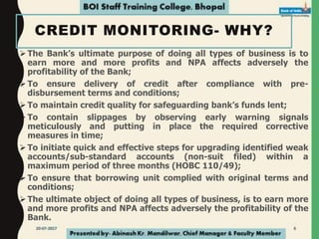

Slide 6
Credit monitoring at the pre-operational stage refers to the process of assessing and monitoring the creditworthiness of a borrower or counterparty before they have commenced operations or before a project has become operational. It is a proactive approach to evaluate the credit risk associated with the entity or project before significant financial commitments are made.
Key Aspects:
Credit Assessment
Financial Analysis
Industry & Market Evaluation
Risk Mitigation measures
Ongoing monitoring
Due Diligence
Regular reporting & Communication

Slide 7
Credit monitoring at the post-operational stage refers to the process of ongoing assessment and surveillance of a borrower's creditworthiness and financial performance after they have commenced operations or after a project has become operational. It involves monitoring key financial and operational indicators to ensure that the borrower remains financially stable and capable of meeting their credit obligations.
Key Aspects:
Financial Performance Analysis
Compliance Monitoring
Operational Performance Evaluation
Industry & Market analysis
Ongoing Relationship Management
Risk Identification & Mitigation
Periodic Reporting

Slide 9
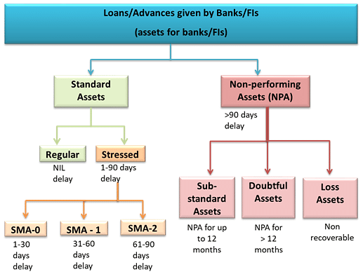

Slide 14
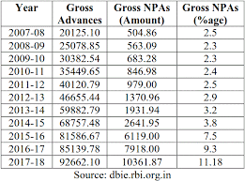
NPA percentage year wise

Slide 15
THANK YOU

