Slide 1
Session-2
Credit Monitoring & NPA Management

Slide 2
Ratios relevant to NPA
NPA stands for Non-Performing Assets, which refers to loans or advances that have stopped generating income for the lender. NPA ratios are financial metrics used to assess the quality of a bank's loan portfolio and its ability to manage credit risk.
Here are some ratios relevant to NPA:
Gross Non-Performing Asset Ratio
Net Non-Performing Asset Ratio
Provision Coverage Ratio
NPA to Assets Ratio

Slide 3
Gross Non-Performing Assets Ratio: This ratio measures the proportion of a bank's total loan portfolio that is classified as non-performing. It is calculated by dividing the total gross NPAs by the total gross advances and multiplying by 100. The formula is:
Gross NPA Ratio = (Gross NPAs / Gross Advances) * 100

Slide 4
Net Non-Performing Assets Ratio: This ratio takes into account provisions made by the bank to cover potential loan losses. It indicates the net impact of non-performing loans on a bank's profitability and financial health. The formula is:
Net NPA Ratio = (Net NPAs / Net Advances) * 100
Net NPAs = Gross NPAs - Provisions

Slide 5
Provision Coverage Ratio: This ratio measures the extent to which a bank has set aside provisions (reserves) to cover potential losses due to non-performing assets. A higher provision coverage ratio indicates a better cushion against potential losses. The formula is:
Provision Coverage Ratio = (Provisions for NPAs / Gross NPAs) * 100

Slide 6
NPA-to-Assets Ratio: This ratio assesses the impact of non-performing assets on a bank's total assets. It shows the percentage of a bank's total assets that are tied up in non-performing loans. The formula is:
NPA-to-Assets Ratio = (Gross NPAs / Total Assets) * 100

Slide 7
Reasons for NPA in banking sector
Following are the reasons for NPA in Banks:
Economic Downturn
Inadequate Credit Assessment
Lack of monitoring and follow up
Poor Risk Management Practices
Willful Default or Fraud
External factors like natural disaster, political instability

Slide 8
Concept of Tier-1 & Tier-2 Capital
Tier-1 and Tier-2 capital are categories of capital used to measure a bank's financial strength and ability to absorb losses. They are components of a bank's regulatory capital requirements, which are mandated by regulatory authorities to ensure the stability and solvency of financial institutions
Tier-1 Capital: Tier-1 capital is the core capital of a bank and represents the highest quality capital available to absorb losses without the bank being required to cease its operations. It primarily consists of shareholders' equity, retained earnings, and disclosed reserves. Tier-1 capital is considered the most reliable form of capital as it is fully available to cover losses and provides a cushion against financial stress.
Tier-1 capital includes the following components:
Common Equity Tier-1 (CET1): It represents the highest-quality capital, consisting of common shares and retained earnings.
Additional Tier-1 (AT1) Capital: It includes instruments such as perpetual bonds or preference shares that have features of equity and can absorb losses on an ongoing basis.
Tier-1 capital is crucial for a bank's financial stability and is an important indicator of its ability to withstand adverse economic conditions and absorb losses.

Slide 9
Tier-2 Capital: Tier-2 capital is supplementary capital that provides additional loss-absorbing capacity to a bank. It is less secure than Tier-1 capital and can only be used to absorb losses after Tier-1 capital has been exhausted. Tier-2 capital includes items such as subordinated debt, undisclosed reserves, revaluation reserves, and long-term loan-loss provisions.
Tier-2 capital serves as a secondary layer of protection for a bank's solvency. It provides an extra buffer against losses and helps maintain the bank's financial strength during periods of stress.

Slide 10
Requirement of Tier-1 & Tier-2 Capital as per RBI
Tier-1 Capital Requirement:
Common Equity Tier-1 (CET1) Capital: The minimum requirement for CET1 capital is 5.5% of a bank's risk-weighted assets (RWA).
Tier-2 Capital Requirement:
Tier-2 Capital: The minimum requirement for Tier-2 capital is 2.0% of a bank's RWA

Slide 12
Reserve norms as per RBI
Cash Reserve Ratio (CRR): Banks are required to maintain a certain percentage of their net demand and time liabilities (NDTL) as cash reserves with the RBI. The CRR is set by the RBI and is subject to periodic changes. The CRR for scheduled commercial banks is typically 3-4% of their NDTL.

Slide 13
Provisioning Norms for Non-Performing Assets (NPAs):
Standard Assets: Banks are required to set aside a certain percentage of provisions for standard assets. The provisioning percentage for standard assets may vary depending on the type of exposure (e.g., retail, corporate) and the risk rating assigned to the borrower.
Non-Performing Assets (NPAs): Banks need to make higher provisions for NPAs based on their classification and age. The provisioning requirements for NPAs are as follows:
Substandard Assets: Banks are required to make provisions ranging from 15% to 100% of the outstanding amount, depending on the age of the NPA.
Doubtful Assets: Provisioning requirements range from 25% to 100% based on the age of the NPA.
Loss Assets: Full provision of 100% is required.
Additional Provisioning for Stressed Assets: The RBI may also direct banks to make additional provisions for stressed assets, such as those identified under the framework for resolution of stressed assets.

Slide 15
Types of Arbitration
Ad Hoc Arbitration: Ad hoc arbitration refers to arbitration proceedings that are conducted without the involvement of any specific arbitral institution. In ad hoc arbitration, the parties have greater flexibility in determining the arbitration procedure and appointing arbitrators. The process is generally guided by the provisions of the Arbitration and Conciliation Act, 1996.
In ad hoc arbitration, the parties are responsible for managing the arbitration process, including selecting arbitrators, setting rules and procedures, and overseeing the arbitration proceedings. The Act provides certain default rules and procedures that apply to ad hoc arbitration in case the parties have not agreed on specific rules.
2. Institutional Arbitration: Institutional arbitration involves arbitration proceedings administered by recognized arbitral institutions or organizations. These institutions provide administrative support and services to parties involved in arbitration. They have established rules, procedures, and panels of arbitrators to facilitate the arbitration process.

Slide 16
Characteristics of Arbitration
Voluntary: Arbitration is a voluntary process, meaning that parties must agree to submit their dispute to arbitration.
Neutral and Impartial: Arbitration aims to provide a neutral and impartial forum for resolving disputes.
Private and Confidential: Arbitration proceedings are generally conducted in private, away from the public eye. The confidentiality of the arbitration process is often maintained, ensuring that the details of the dispute and the proceedings remain confidential, unlike court litigation, which is generally public.
Party Autonomy: Arbitration allows parties to exercise a significant degree of autonomy and control over the process.
Final and Binding Decision: Arbitration results in a final and binding decision, known as an arbitral award. The arbitral award is enforceable under the law and can be executed as if it were a court judgment.
Expertise and Specialization: Arbitration often allows parties to choose arbitrators who have expertise and experience in the specific subject matter of the dispute.

Slide 17
Characteristics of Arbitration….contd….
7. Flexibility and Efficiency: Arbitration is known for its flexibility compared to court litigation. The parties have more control over the process, including the timing of hearings, the presentation of evidence, and the overall procedural aspects. This flexibility allows for a more efficient and streamlined dispute resolution process.
8.International Reach: Arbitration is widely used for resolving international disputes, as it transcends national boundaries. International arbitration enables parties from different countries to resolve their disputes in a neutral forum, often under internationally recognized arbitration rules and conventions.

Slide 18
Advantages of Arbitration
Speed & Efficiency
Flexibility & Party Autonomy
Expertise & Specialization
Confidentiality
Neutrality & Impartiality
Finality & Enforceability
Cost Savings
International Reach
Preserves Business Relationship

Slide 25
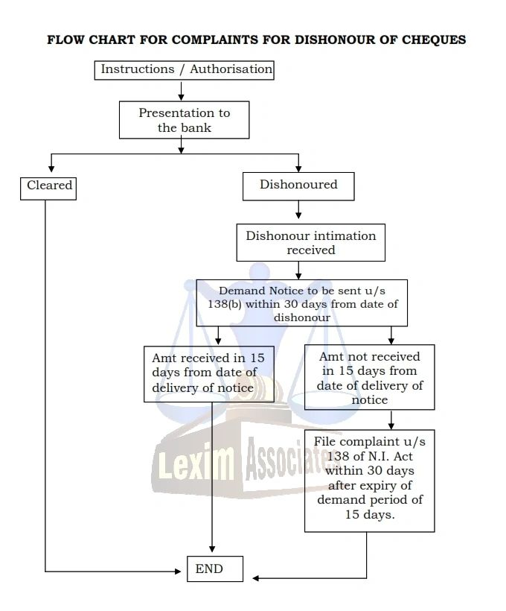
Role of Section-138

Slide 26
Role of Section-9 in repossession of Assets

Slide 27
THANK YOU

