Slide 1
Credit Risk Modelling

Slide 2
Credit risk modelling refers to the process of using data models to find out two important things. The first is the probability of the borrower defaulting on the loan. ... Financial institutions rely on credit risk models to determine the credit risk of potential borrowers

Slide 3
Internal Rating Based (IRB) Approach
Following are the four different Credit Risk Components in IRB Approach:
Probability of Default (PD)
Exposure at Default (ED)
Loss Given Default (LGD)
Effective Maturity (EM)

Slide 4
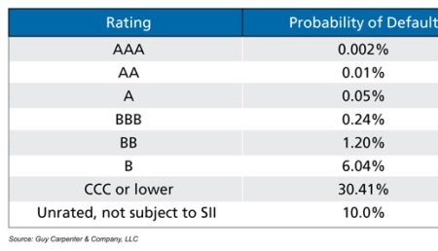
Probability of default means the likelihood that a borrower will default on debt (credit card, mortgage or non-mortgage loan) over a one-year period. In simple words, it returns the expected probability of customers fail to repay the loan. Probability is expressed in the form of percentage, lies between 0% and 100%. Higher the probability, higher the chance of default.

Slide 5
Exposure at Default means how much should we expect the amount outstanding to be in the case of default. It is the amount that the borrower has to pay the bank at the time of default

Slide 6
Loss Given Default (LGD) means how much of the amount outstanding we expect to lose. It is a proportion of the total exposure when borrower defaults. It is calculated by (1 - Recovery Rate).

Slide 8
How to find out Loss Given Default?
Someone takes $100,000 home loan from bank for purchase of flat. At the time of default, loan has an outstanding balance of $70,000. Bank foreclosed flat and sold it for $60,000. EAD is $70,000. LGD is calculated by dividing ($70,000 - $60,000)/$70,000 i.e. 14.3%.

Slide 9
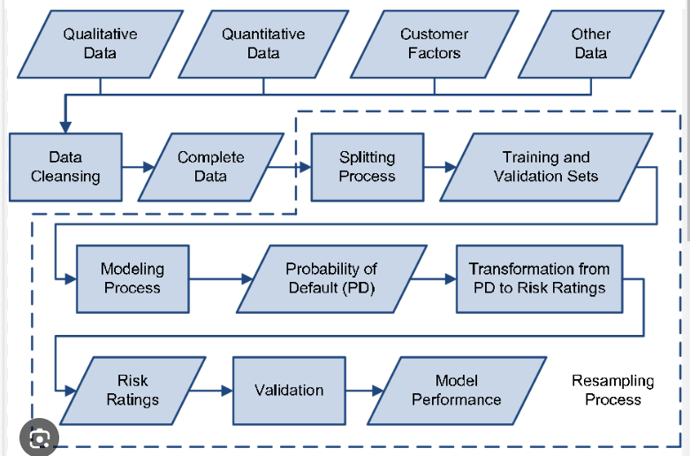

Slide 10
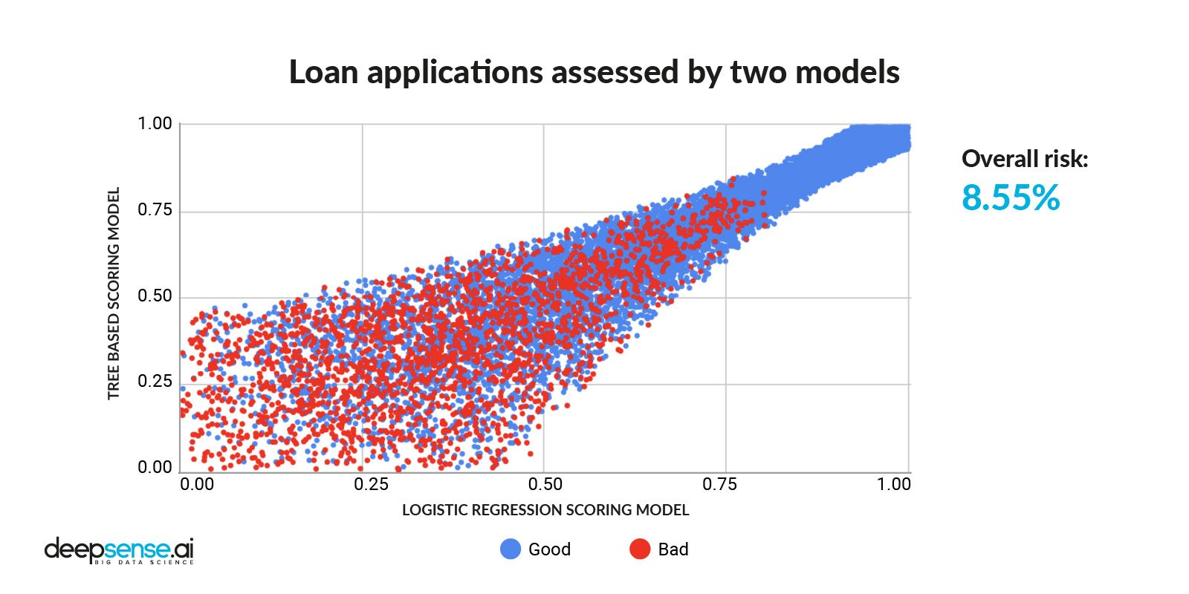

Slide 11
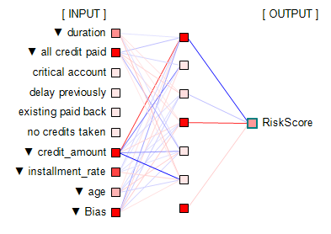

Slide 12
Credit Risk Model Validation Techniques
Data Review
Performance Metrics
Back testing
Stress Testing
Sensitivity Analysis
Benchmarking
Model Governance
Expert Judgement
Regulatory Compliance

Slide 13
Altman Z Score:
One of the famous credit score model used in Banks/NBFCs/ Investors..
Altman Z Score Formula
Z score=1.2(A) + 1.4(B)+3.3(C )+0.6(D)+1(E)
1.2, 1.4, 3.3, 0.6 & 1 are multiplication factor/co-efficients
A=Working Capital/Total Assets (Measures Liquidity)
B=Reserve/Total Asset (Measures accumulated profit compared to assets)
C=PBDIT/Total Assets (Measures company’s assets contribution to profit)
D=Market value of equity/Total Liability (Measures company’s value Vs Liability)
E=Sales/Total Assets (Measures company’s assets’ contribution to Sales)

Slide 14
THANK YOU

