Slide 1
Session-1
Corporate Banking Facilities and other Financing Forms

Slide 2
A brief about Wholesale Banking
Wholesale banking refers to banking services sold to large clients, such as other banks, other financial institutions, government agencies, large corporations, and real estate developers.
It is the opposite of retail banking, which focuses on individual clients and small businesses.
Wholesale banking services include currency conversion, working capital financing, large trade transactions, mergers and acquisitions, consultancy, and underwriting, among other services.

Slide 3
Products of Wholesale Banking
Asset Management
Working Capital Finance
Merger & Acquisition Finance
Forex Loan
Loan Participation
Merchant Banking
Loan Syndication

Slide 5
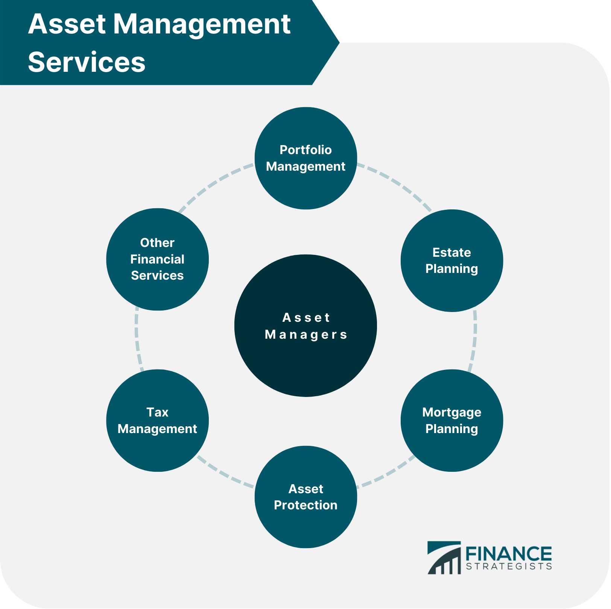

Slide 6
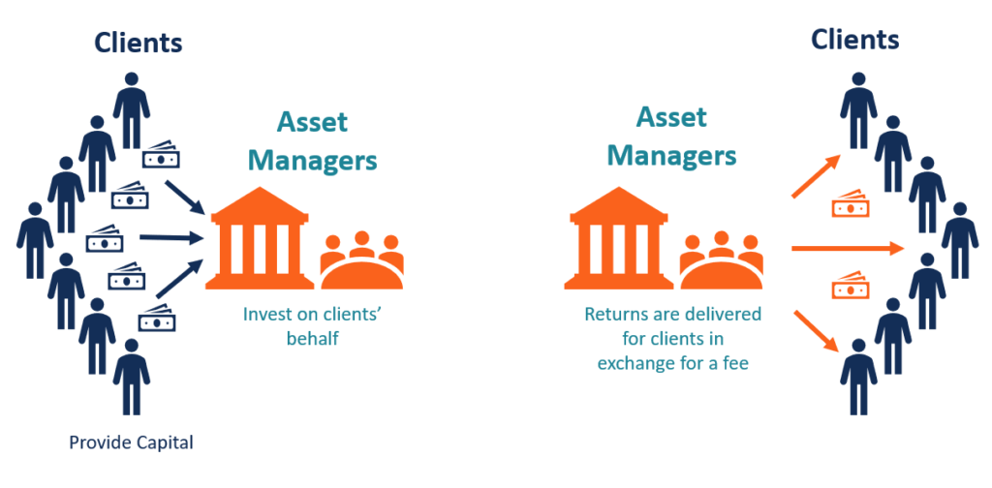
Asset Management Process

Slide 7
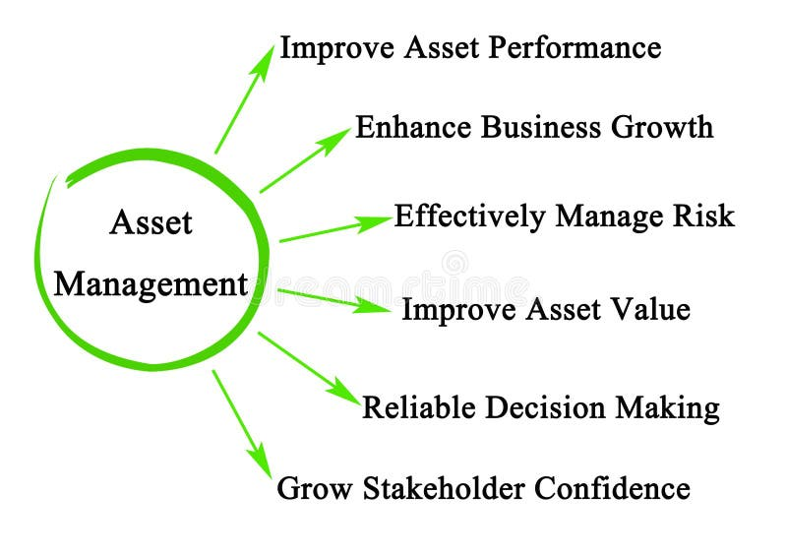
Advantages of Asset Management

Slide 8
Working Capital Finance

Slide 15
Foreign Currency Loan
Foreign Currency Term Loan( popularly known as FCTL) is the replacement for Term Loan in INR by Foreign Currency Term Loans (FCTL) that can be disbursed in four currencies viz. US$, Sterling, Euro and Japanese Yen with a maturity period of 6 months to 7 years. It can be repaid by bullet payment or in stipulated instalments or by conversion of rupee term loans, as per the terms of the original sanction.

Slide 17
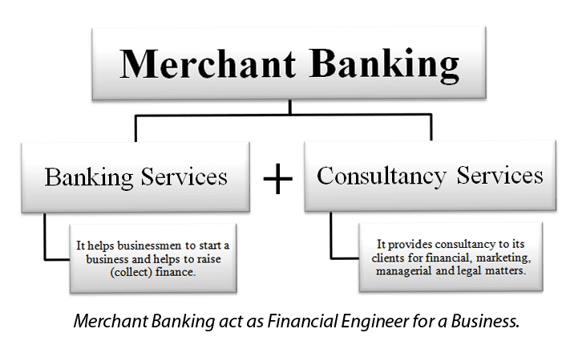

Slide 19
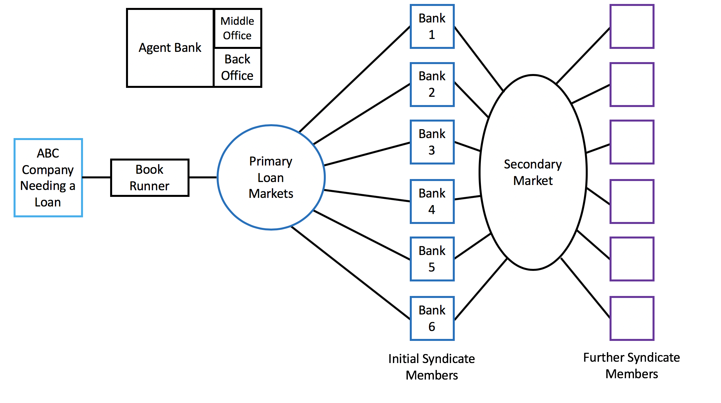

Slide 21
THANK YOU

