Slide 1
Session-2
Corporate Banking Facilities and other Financing Forms

Slide 4
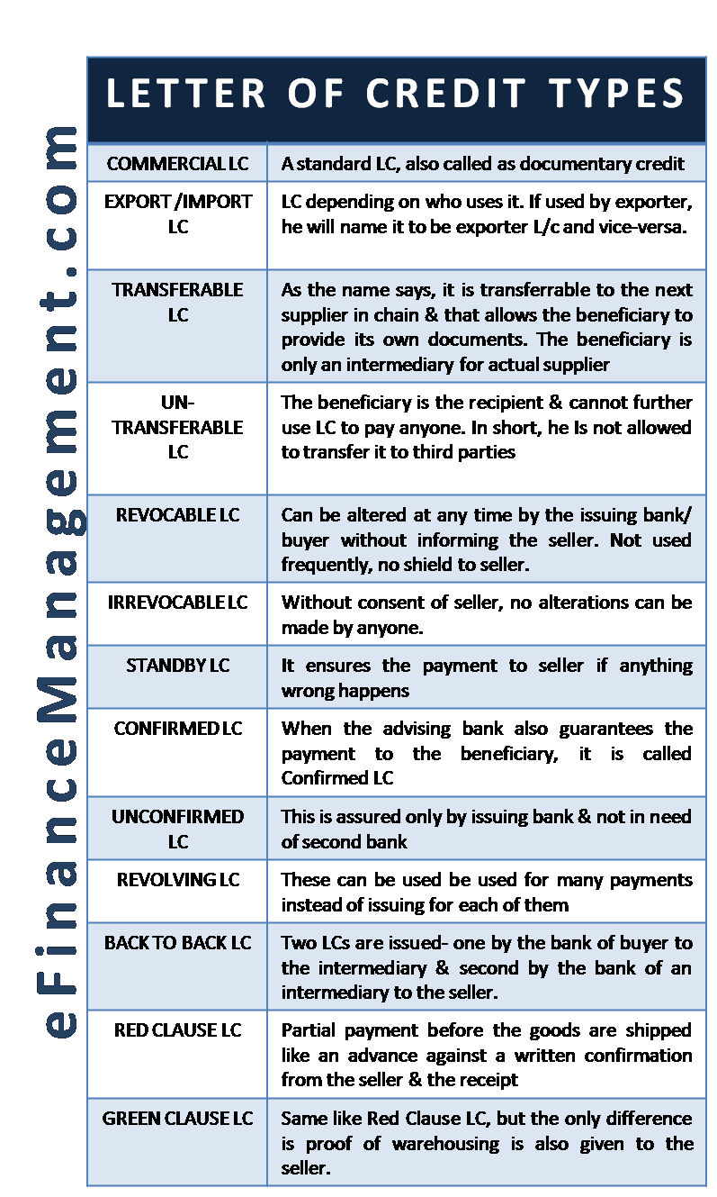

Slide 5
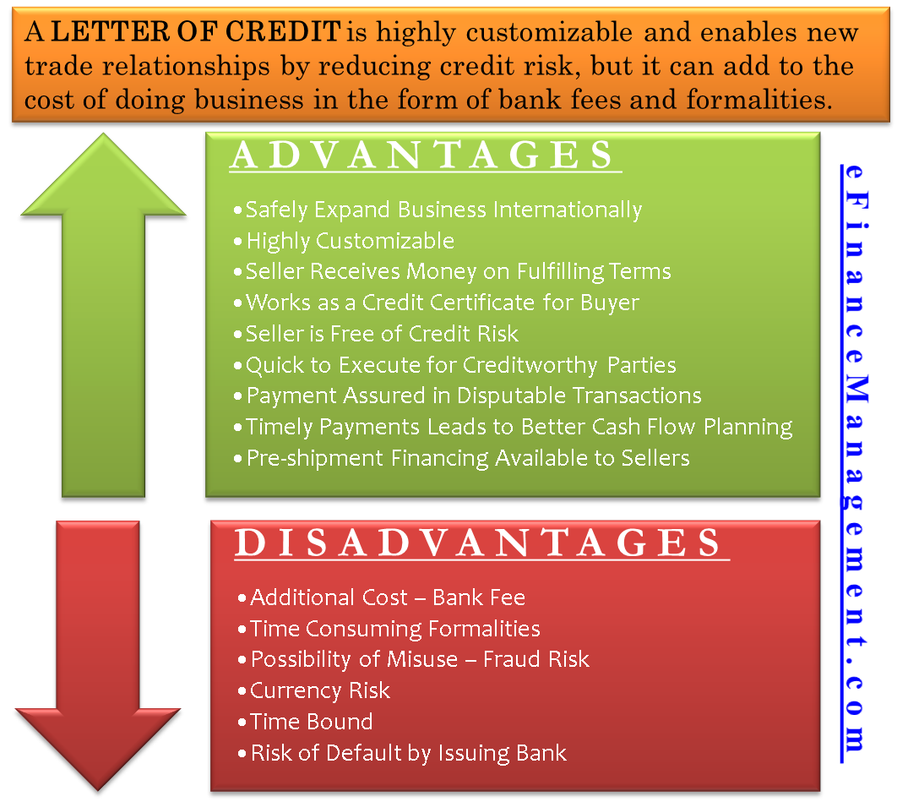

Slide 8
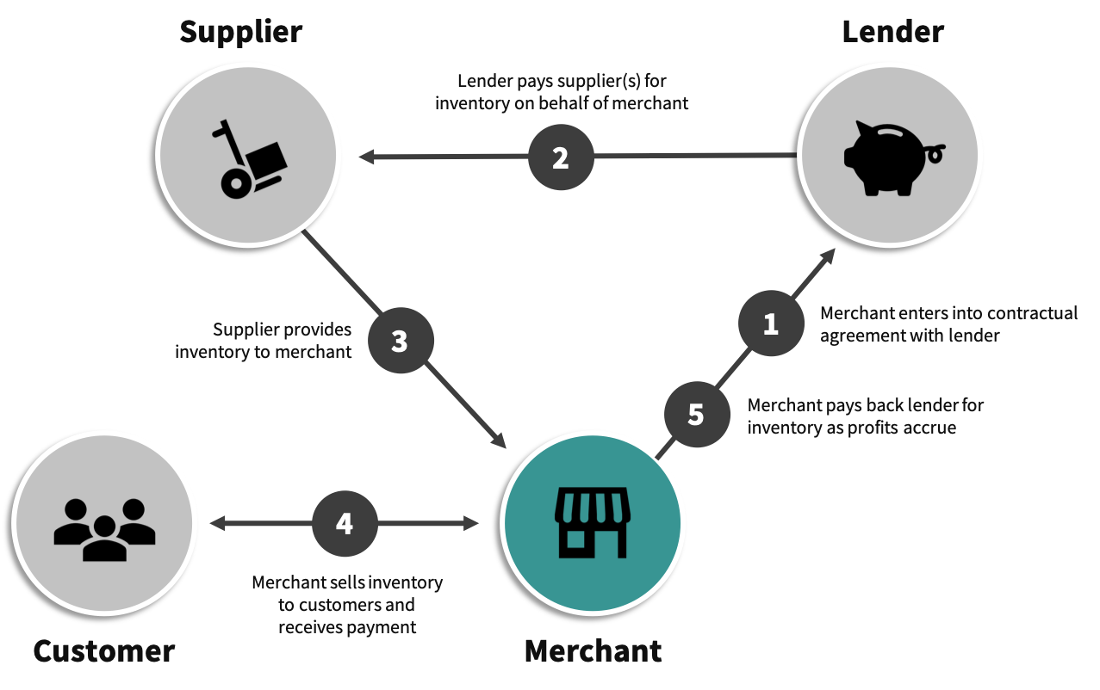
Process of Inventory Financing

Slide 9
Example of Supply Chain Finance
A typical extended payables transaction works as follows: Let’s say the buyer, Company ABC, purchases goods from the seller, Supplier XYZ. Under traditional circumstances, Supplier XYZ ships the goods, then submits an invoice to Company ABC, which approves the payment on standard credit terms of 30 days. But if Supplier XYZ is in dire need of cash, it may request immediate payment, at a discount, from Company ABC's affiliated financial institution. If this is granted, that financial institution issues payment to Supplier XYZ, and in turn, extends the payment period for Company ABC, for an additional further 30 days, for a total credit term of 60 days, rather than the 30 days mandated by Supplier XYZ.

Slide 11
Factoring
Factoring is a financial transaction and a type of debtor finance in which a business sells its accounts receivable to a third party at a discount. A business will sometimes factor its receivable assets to meet its present and immediate cash needs.

Slide 12
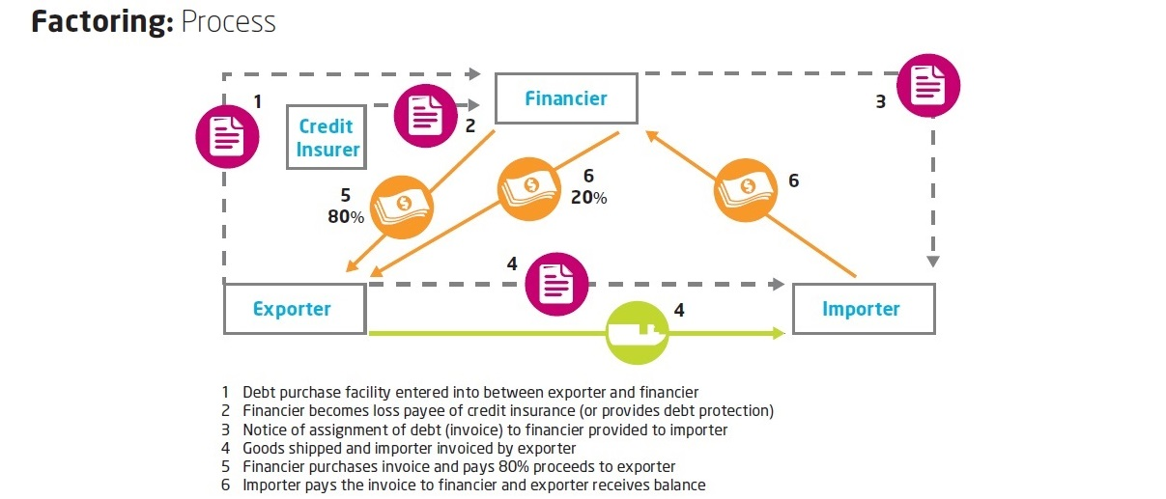

Slide 13
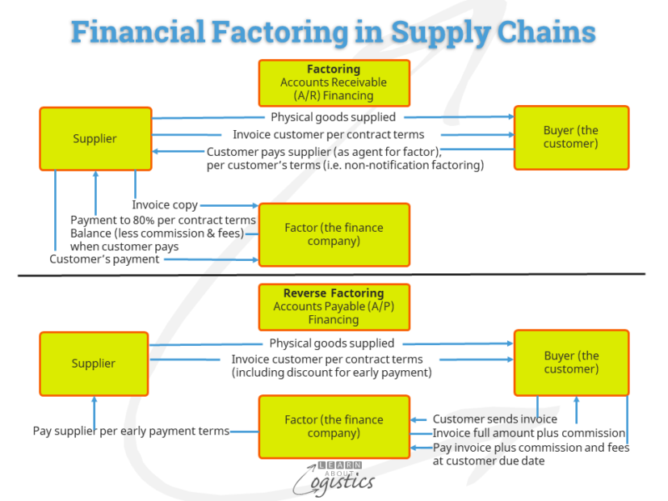

Slide 14
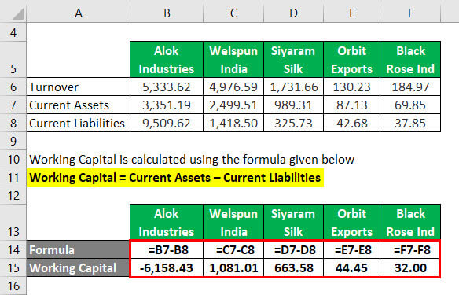

Slide 15
THANK YOU

