Slide 1
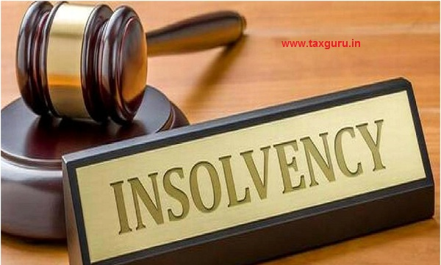
INSOLVENCY & REVIVAL

Slide 3
Background of IBC 2016
Banks in India were going through unprecedented times with stressed loan portfolio touching all-time high. There was an apprehension that there could be further significant additions as many stressed loan accounts had been disguised as standard.
Realizing the problem, RBI had attempted to force banks to clean up balance sheets and come out with many regulatory steps aimed at improving banks’ ability to deal with such stressed accounts. However, such frameworks have proved unsuccessful.
India at that time had multiple laws to deal with insolvency, which lead the entire resolution process fragmented, expensive and time-consuming with very low recovery rate.
In this scenario, the Indian Government had introduced the Bankruptcy and Insolvency Code, 2016 which would consolidate the existing frameworks and create a new institutional structure
The Code created time-bound processes for insolvency resolution of companies and individuals which thereby would help India improve its World Bank insolvency ranking.

Slide 4
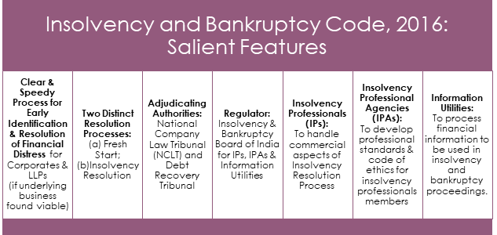

Slide 5
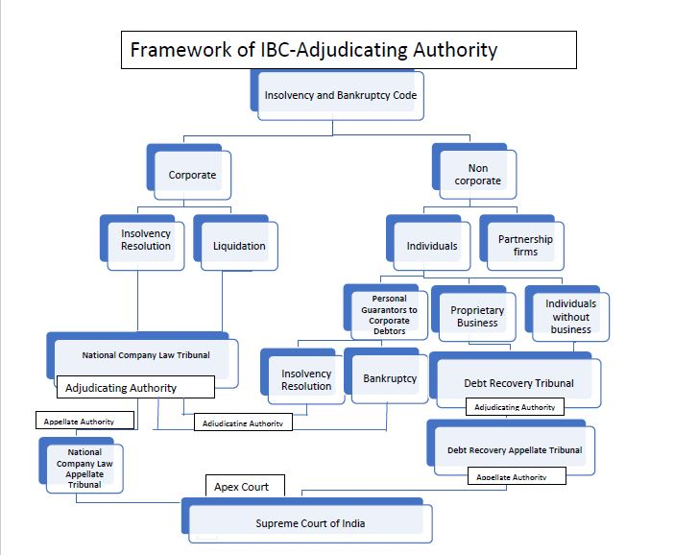

Slide 6
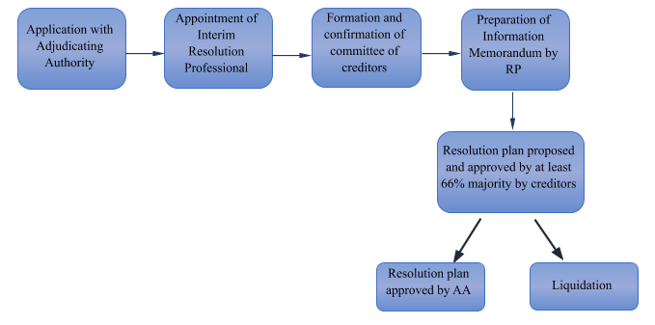
How does IBC 2016 work?

Slide 7
Delinquency Data before IBC 2016
March | 2013 | 2014 | 2015 | 2016
Gross NPA Ratio (%) | 3.27 | 3.86 | 4.37 | 7.61
Net NPA Ratio (%) | 1.72 | 2.17 | 2.48 | 4.63
Stressed Asset/Advance (%) | NA | 9.75 | 11.01 | 11.5
PSU
March | 2013 | 2014 | 2015 | 2016
Gross NPA Ratio (%) | 3.59 | 4.34 | 4.94 | 9.6
Net NPA Ratio (%) | 1.99 | 2.53 | 2.9 | 6.1
Stressed Asset/Advance (%) | NA | 11.04 | 12.68 | 14.5
Private Banks
March | 2013 | 2014 | 2015 | 2016
Gross NPA Ratio (%) | 1.86 | 1.82 | 2.14 | 2.7
Net NPA Ratio (%) | 0.52 | 0.63 | 0.87 | 1.3
Stressed Asset/Advance (%) | NA | 4.29 | 4.59 | 4.5

Slide 8
Legal framework of IBC 2016
Law/Act | Dealt with
Presidency Town Insolvency Act, 1909/Provincial Insolvency Act 1920/Indian Partnership Act | Applicable to Individuals & Partnerships
Companies Act 2013/1956 | Deals with rehabilitation / revival / winding up of companies; only court supervised winding up available now under the 2013 Act; other proceedings under the Code
Limited Liability Partnership Act, 2008 r/w. Limited Liability Partnership (Winding up and Dissolution) Rules, 2012 | No provisions for rehabilitation / revival of LLPs
SICA | Revival / rehabilitation of only sick industrial companies
SARFAESI / Recovery of Debt Due to Banks and Financial Institutions Act, 1993 | Debt recovery / enforcement of security No revival / rehabilitation of the defaulting entity
CDR , JLF, SDR and S4A | Introduced by RBI as out of court process No legal sanction

Slide 9
Objectives of IBC, 2016
To promote entrepreneurship;
To make credit available
To balance the interest of all stakeholders by consolidating and amending the existing laws relating to insolvency and bankruptcy
To reduce the time of resolution for maximizing the value of assets
The key theme of the Code is to consolidate all laws relating to insolvency of companies, limited liability entities, unlimited liability partnership and individuals.

Slide 10
Cases ideal for IBC, 2016
When account has become irregular and Bank is of the view that borrower is taking matter casually
When there are multiple lenders and
Client is keeping account of a few lenders regular but others irregular
When lenders are not able to reach consensus quickly
When certain lenders with senior debt (1st charge holders) or other privileges are dominant and unfair to junior debt (unsecured or 2nd charge holders)
TRA mechanism is not benefitting some lenders in just manner.

Slide 11
Cases ideal for IBC 2016….continued….
When security coverage is low or very difficult to realise.
When lenders apprehend that the account is likely to go bad and borrower can siphon away funds or strip assets
Cases where SARFAESI or RDDB can not be applied, but still the account is showing signs of stress and needs resolution within legal framework
When lenders doubt about integrity and/or managerial capabilities of existing promoters
When lenders expect genuine interest for change of management

Slide 12
Cost of Insolvency Proceeding
COC-Committee of Creditors
Cost Head | Borne By | Remark
Application Fee | Applicant | Rs. 2000 if applicant is operational creditor else 25000
Public Announcement cost | Applicant | Not to form part of IRP
IRP Fee | Applicant/Debtor | Fixed by Applicant. To be borne by the debtor to the extent ratified by COC
Other cost including Valuer’s Fees, Forensic Audit Cost, professional advisors appointed by IRP | Applicant/Debtor | To the extent ratified by COC
RP Cost | Debtor | COC to fix
Cost of interim finance | Debtor | COC to fix limit of interim finance
Other Insolvency Resolution Process Cost | Debtor | To be approved by COC

Slide 13
Advantages of IBC
Creditors in control as most decision making with the lenders.
Time bound and quick solution for stressed and NPA accounts.
Change of management possible.
Brings financial lenders to a platform – enabling quick decision making and arriving at consensus quickly.
Prepare and examine resolution plan by professionals appointed by creditors ensuring fearless decision making
Final approval by NCLT (a legal entity) – so less stress/fear of accountability/ vigilance.
Fair chance to viable and sustainable units for time bound revival.
In cases of unviable accounts, faster, transparent and smooth liquidation process
Clear and fair distribution of funds in case of liquidation. Government dues to get last priority
Protection of assets of secured borrowers with maximisation of realisation.
Positive support from government for realisation and resolution of NPAs

Slide 14
SARFAESI Vs IBC
SARFAESI doesn’t consider revival while IBC first considers revival
SARFAESI doesn’t provide control with Creditors while IBC provides the same through IRP
SARFAESI doesn’t provide priority of payment to secured creditors over all Govt and Statutory dues
Under SARFAESI physical possession passes on to lenders obligating them to arrange for security and maintenance while under IBC it becomes responsibility of an independent agency.
SARFAESI provides exclusive power to secured creditors and also differentiates between 1 st charge and 2nd charge holders while in IBC all financial creditors are considered at par
Under IBC quick change of management is possible while under SARFAESI change of ownership / management is possible, but cumbersome.
SARFAESI process is more time consuming.
Legal/administrative hurdles of involving DM, Local PS and Trade Unions is passed on to independent process.

Slide 15
REVIVAL OF GENERAL MOTORS
General Motors is one of the renowned Name in the world of Auto Industry.
Some of the famous Brands in India are:
Opel Astra
Opel Corsa
Chevrolet (Tavera, Cruz, Beat)

Slide 16
What went Wrong with GM- some key pointers…
GM makes cars people don’t want
GM was too slow to innovate because of its size
GM was too bureaucratic and unable to adjust to changing markets
GM’s dealer network is too large

Slide 17
Steps taken by GM as Remedial Measure:
The Company identified the good business units and transferred them to a newly formed company
Was able to get $45 bn dollar Govt Funding
Agreement with Govt & GM's board to do the new company plan
A qualified successor in place- MR. FRITZ
Treasury agreed to fully fund the new company with Equity
In June 2009, GM filed for bankruptcy in New York, with $82 billion assets & $ 173 billion liabilities…largest bankruptcy in the world
New GM exited Bankruptcy Protection on July 10, 2009 in a mere 40 days
The company got its fresh start using the new company plan & the industry was saved with Govt funding from both Bush & Obama

Slide 18
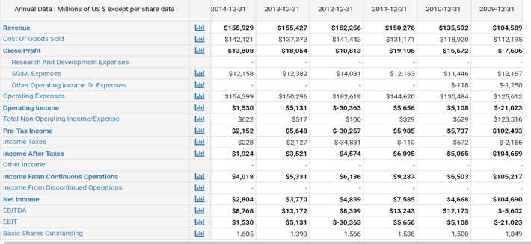
Financials of General Motors

Slide 19
THANK YOU

