Slide 1
Session-2

Slide 2
Contents
About Ratio Analysis
Importance of Ratio Analysis
Accounting Ratios
Liquidity Ratios- Formulae and example
Profitability Ratio
Different Profitability Ratio with Formulae
Activity Ratio with Different Activity Ratio with Formulae
Leverage Ratio
Different Leverage Ratio with formulae
Company to Company Comparison based on Ratio Analysis
Industry to Industry Comparison based on Ratio Analysis
Surprise Test

Slide 7
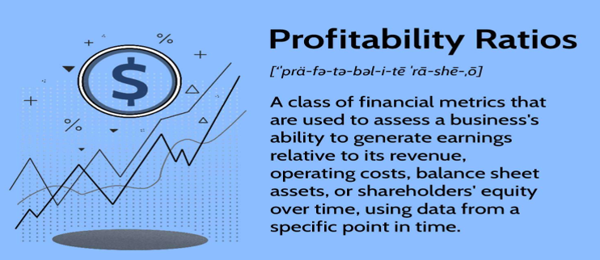

Slide 8
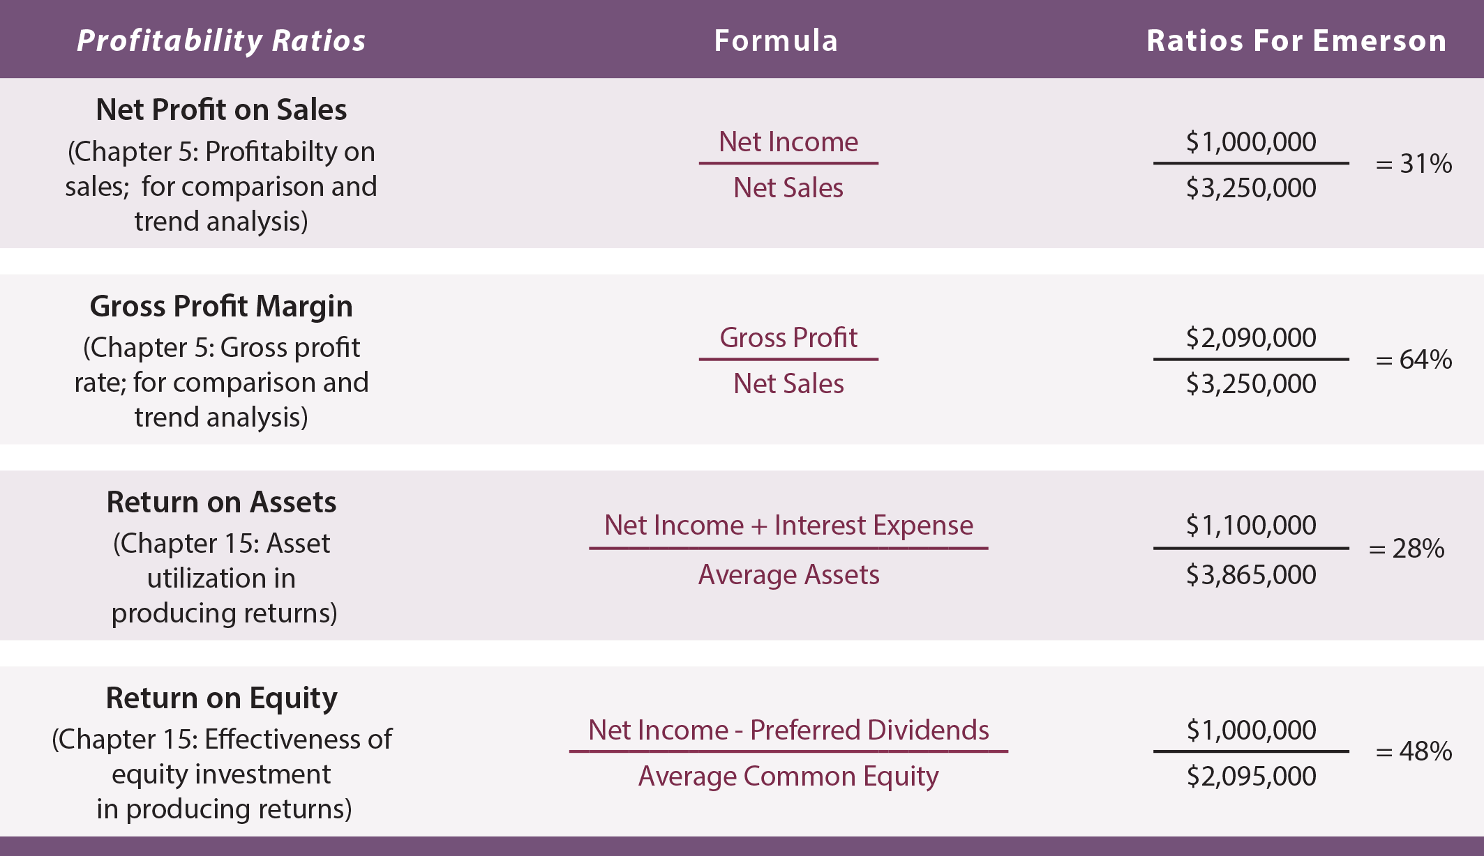

Slide 11
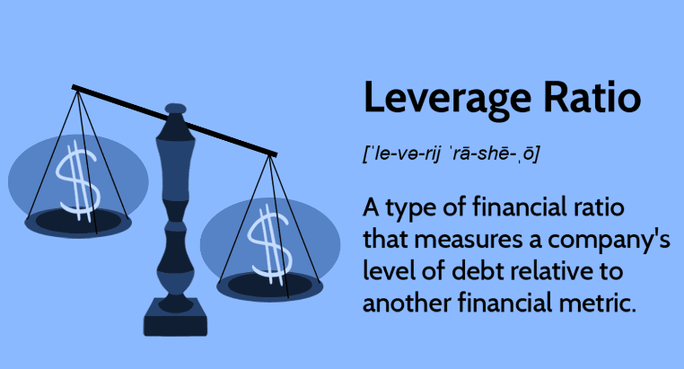

Slide 13
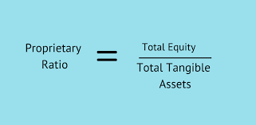

Slide 14
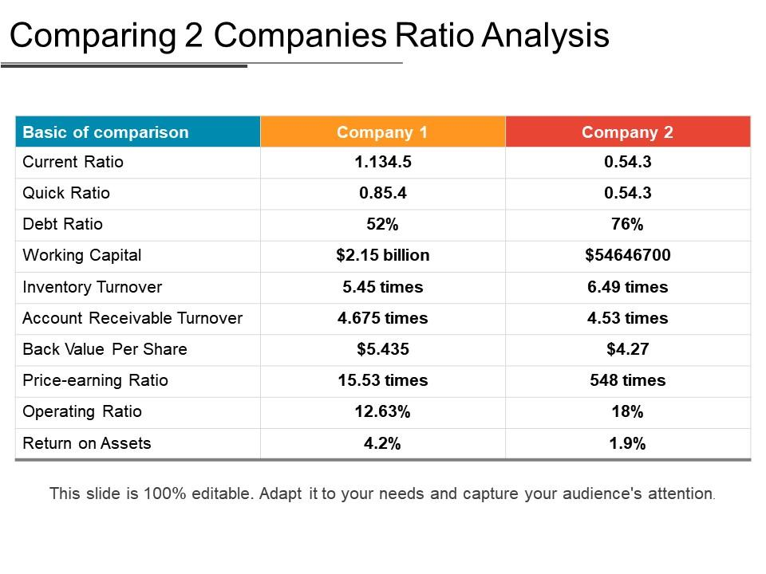

Slide 15
Ratio- Industry to Industry Comparison

Slide 18
THANK YOU

