Slide 1
Session-2
BANKER & ANALYST’S PERSPECTIVE

Slide 2
Corporate underwriting is the process of evaluating the financial viability and profitability of investment projects undertaken by a company.
It helps companies make informed decisions by assessing the expected cash flows, risks, and potential returns of a project

Slide 4
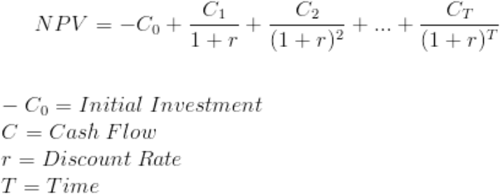

Slide 6
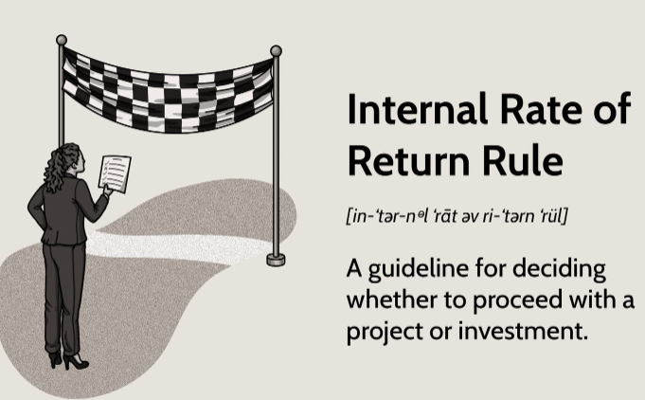
The internal rate of return (IRR) is a financial metric used to evaluate the profitability of an investment or project. It represents the discount rate at which the net present value (NPV) of the investment becomes zero.
In other words, it is the interest rate at which the present value of the investment's cash inflows equals the present value of its cash outflows.

Slide 7
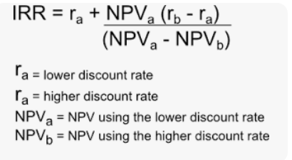

Slide 8
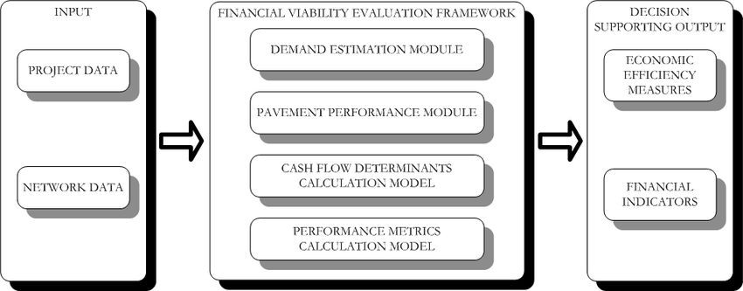

Slide 9
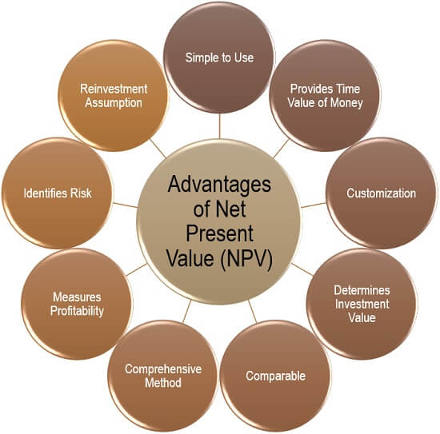

Slide 12
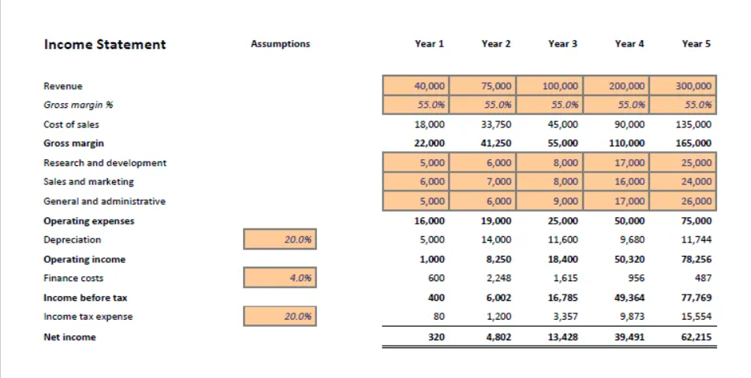
Discount Rate=5%. Find out NPV and IRR (with higher discount rate-7%)

Slide 13
THANK YOU

