Slide 1
Session-1
Bonds & Loans

Slide 3
Types of Bonds
Treasury Bonds
Government Bonds
Corporate Bonds
Junk Bonds
Foreign Bonds
Mortgage-Backed Bonds
Municipal Bonds

Slide 4
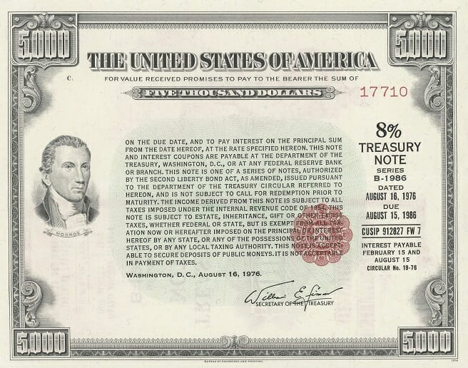
Treasury Bond:
Treasuries are issued by the federal government to finance its budget deficits. Because they're backed by Uncle Sam's awesome taxing authority, they're considered credit-risk free. The downside: Their yields are always going to be lowest (except for tax-free municipal bond). But in economic downturns they perform better than higher-yielding bonds, and the interest is exempt from state income taxes.

Slide 11
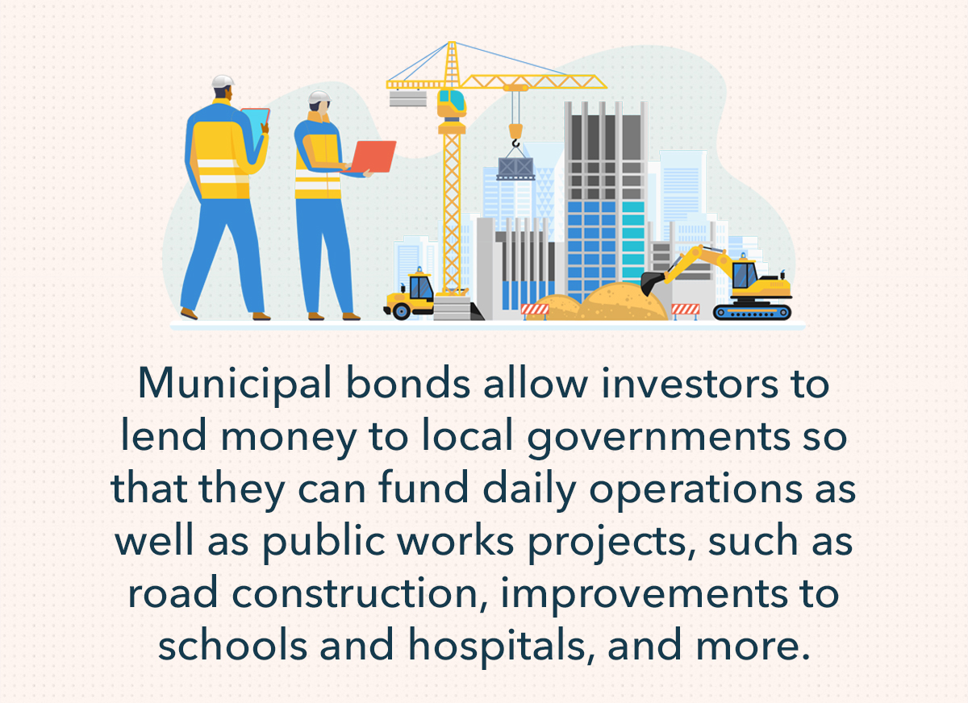

Slide 13
Bond Value- Brainstorming
5 year Rs. 1000 par value bond, bearing a nominal rate of interest of 7% per annum. The investor’s required rate of return is 8%. We are required to find out the purchase price investor is willing to pay for the Bond now…
The investor will receive Rs. 70 as interest every year for 5 years and Rs. 1000 on maturity (i.e. at the end of 5th year). Calculate the Present Value of the Bond

Slide 15
Brainstorming YTM

Slide 19
YTW- Brainstorming
Find out Yield To Worst (YTW)
Face value (par value): $1,000
Coupon rate: 5%
Maturity: 10 years
Callable after: 5 years
Call price: $1,050

Slide 20
Pure Discount Bond
Pure Discount Bond provides for the payment of a lump sum amount at a future date in exchange for a current price of the Bond. The difference between face value and its purchase price gives the return or YTM of the bond. This is also called Deep Discount Bond or Zero Interest Bond or Zero Coupon Bond.

Slide 21
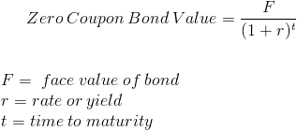

Slide 22
Brainstorming on Zero Coupon Bond
Face Value=10000
R= 8%
Time to maturity=25 Years
Find out the value of Zero Coupon Bond

Slide 23
Value of a Bond and interest rate relation

Slide 24
Value of a Bond, Interest Rate and maturity relation

Slide 25
THANK YOU

