Slide 1
Session-2
Bonds & Loans

Slide 3
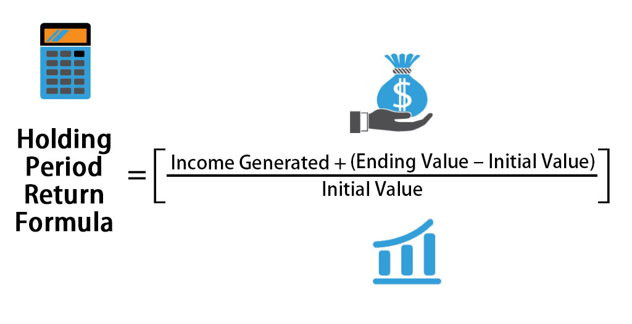

Slide 4
Brainstorming on HPR
You purchased a stock for INR 50 per share. Over a period of one year, you receive dividend of INR 2 per share. At the end of the end of the year, you sold stock at INR 60 per share. Calculate Holding period return.

Slide 5
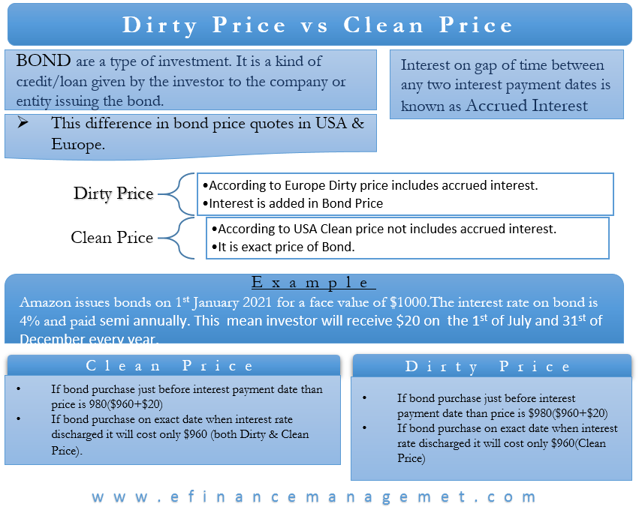

Slide 6
Brainstorming on Clean Price & Dirty Price
The face value of a bond is INR 10000. Coupon rate is 5%, a remaining time to maturity is 5 years and YTM is 4%. Find the Clean price of the Bond.
The face value of a bond is INR 10000. Coupon rate is 5%, a remaining time to maturity is 5 years, out of which 6 months passed, YTM is 4%. Find out the Dirty Price of the Bond.

Slide 8
Let's consider a corporate bond issued by XYZ Company. The bond has the following characteristics:
Face Value: $1,000
Coupon Rate: 5%
Maturity: 5 years
Market Interest Rate: 6%
1.Relationship with Market Interest Rates: Assuming the bond is issued when the market interest rate is 6%, the bond's coupon rate of 5% suggests it has a lower yield compared to the prevailing market rate. Consequently, the bond may be less attractive to investors, resulting in a discount.
2. Credit Risk: If XYZ Company's creditworthiness weakens, investors may perceive it as riskier. This perception may result in a downgrade of the bond's credit rating. Assuming the bond's credit rating is lowered, the market may require a higher yield to compensate for the increased credit risk. Let's assume a credit downgrade leads to an increase in the bond's yield to 7%.
3. Maturity: The bond's maturity also influences its yield. Generally, longer-term bonds tend to have higher yields to compensate for the increased risk associated with the longer time horizon. Assuming an upward-sloping yield curve, where longer-term rates are higher, let's say the market interest rate for 10-year bonds is 7.5%.
4. Supply and Demand: The supply and demand for bonds can affect their yields. If the market demand for XYZ Company's bonds increases, the bond's yield may decrease due to increased demand, making it more attractive to investors. Conversely, if demand decreases, the yield may increase. Let's assume increased demand leads to a decrease in the bond's yield to 6.5%.
5. Inflation Expectations: If inflation expectations rise, investors may demand higher yields to protect against the erosion of purchasing power. Assuming inflation expectations increase, let's say investors now require a higher yield of 7%.
Find out the Bond’s Yield

Slide 11
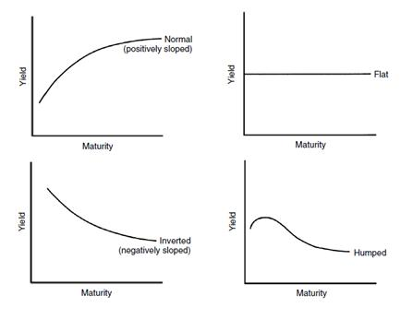
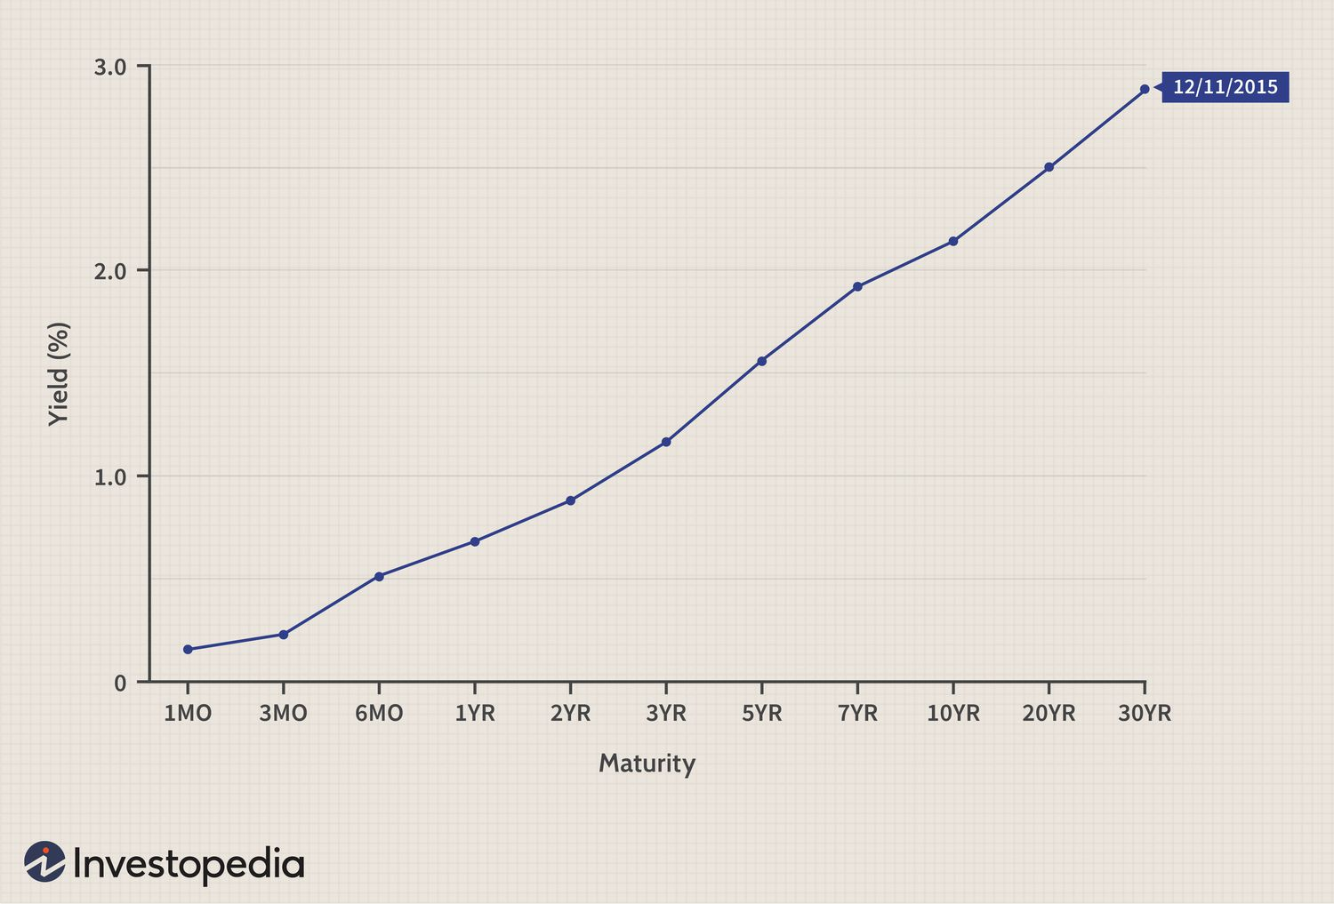

Slide 12
Concept of Modified Duration:
Modified duration is a measure of the sensitivity of a bond's price to changes in its yield or interest rate. It quantifies the percentage change in the bond's price for a given change in yield.
Modified duration takes into account the time to maturity, the coupon rate, and the yield of the bond. It is calculated as the weighted average of the time until each cash flow (coupon payments and the bond's face value) is received, with the weights being the present values of those cash flows. The formula for modified duration is as follows:
Modified Duration = (1/P) * ∑ [T * PV(T) * CF(T)]
Where: P = Current price of the bond
T = Time until each cash flow is received
PV(T) = Present value of cash flow at time T
CF(T) = Cash flow at time T

Slide 13
Price Value of a Basis Point
The price value of a basis point (PVBP), also known as the dollar value of a basis point (DV01), represents the change in the price of a bond for a 1 basis point (0.01%) change in its yield. It measures the sensitivity of a bond's price to changes in its yield.
To calculate the price value of a basis point, you can follow these steps:
1.Determine the bond's modified duration: Modified duration is a measure of a bond's price sensitivity to changes in yield. It takes into account the bond's time to maturity and coupon payments. The modified duration can be obtained from bond pricing models or provided by financial data sources.
2.Convert the modified duration to a decimal: Divide the modified duration by 100 to convert it to a decimal.
3.Calculate the PVBP: Multiply the modified duration (in decimal form) by the bond's price.
PVBP = Modified Duration (Decimal) × Bond Price

Slide 14
Macaulay Duration
Macaulay duration is a measure of the weighted average time it takes to receive the cash flows from a bond, including both the periodic coupon payments and the final principal payment. It provides an estimate of the bond's price sensitivity to changes in yield.
The formula to calculate Macaulay duration is as follows:
Macaulay Duration = [Σ (t * CFt) / P]
Where:
t represents the time period (usually in years) until each cash flow is received.
CFt represents the cash flow at time period t.
P represents the price of the bond.

Slide 15
Brainstorming on Macaulay Duration
Face value: $1,000
Coupon rate: 5% per year
Maturity: 5 years
Current market price: $950
Find out the Macaulay Duration

Slide 16
Impact of monetary policy on Bonds
1.Interest Rate:
Interest rate is directly proportional to Bond’s Coupon Rate
2. Bond Prices:
Bond prices and yields have an inverse relationship. When interest rates rise due to tighter monetary policy, existing bonds with lower coupon rates become less attractive to investors compared to newly issued bonds with higher coupon rates
3. Market Expectation:
If central banks signal a potential tightening of monetary policy, such as raising interest rates, it may cause bond yields to increase as investors anticipate higher rates.
4. Investor Sentiment:
When central banks adopt tighter monetary policy, it may indicate concerns about inflation or overheating, which could increase risk aversion among investors. This can result in a shift towards safer assets such as government bonds, causing their yields to decrease.
5. Yield Curve:
When central banks raise interest rates, short-term rates tend to increase more quickly compared to long-term rates. This can lead to a flattening of the yield curve, as the yield difference between short-term and long-term bonds narrows. Conversely, when central banks lower interest rates, it can steepen the yield curve as the spread between short-term and long-term yields widens.

Slide 17
THANK YOU

