Slide 1
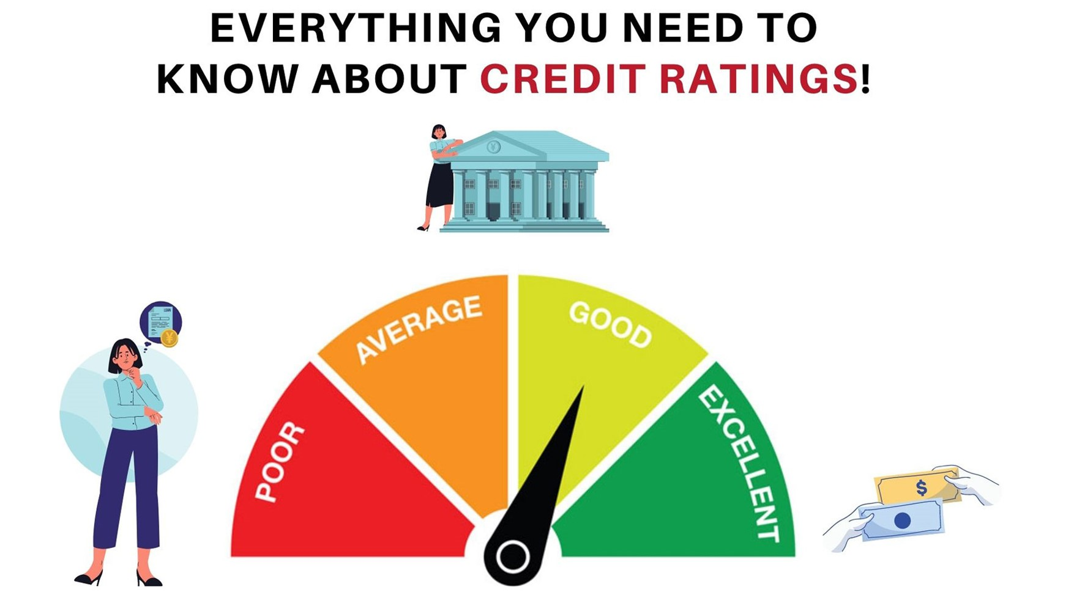
Session-1
Credit Rating, Internal & External- Part-1

Slide 2
Introduction to Credit Rating
Definition
Purpose of Credit Rating
3. Benefits of Credit Rating
4. Role of Credit Rating Agencies
Credit Rating Agencies
5. Major Credit Rating Agencies
6. Credit Rating Methodologies
7. Credit rating Criteria
Credit Rating Process
8. A flow Chart
Factors Considered in Credit Rating
9. Credit rating methodology in details
10. Credit rating criteria
Credit rating process
Factors that affect the credit rating of a company in details
Internal Credit Rating
External Credit Rating
Credit Rating Description
Credit Rating Agency vs Credit Information Company
Case Study

Slide 3
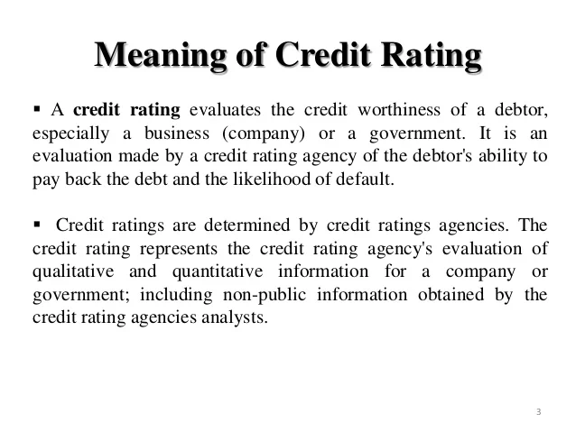

Slide 4
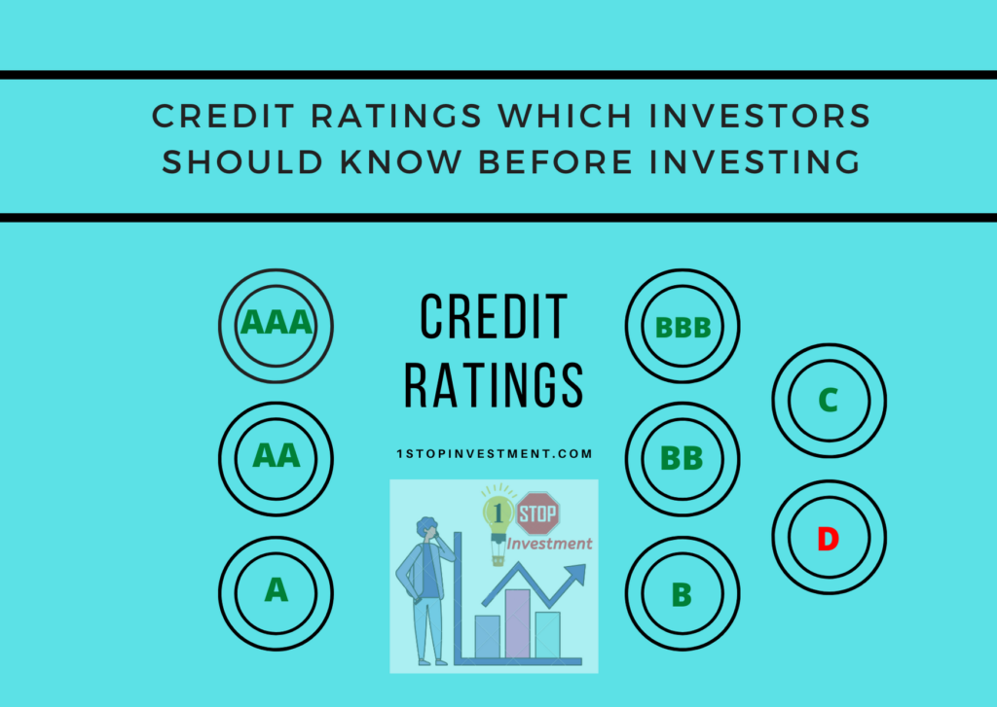
Purpose of Credit Rating
The purpose of a credit rating is to provide an opinion or rating on the credit risk associated with a particular entity or financial instrument, such as bonds or loans. Credit ratings are important for lenders, investors, and other market participants as they help in making informed decisions regarding lending money, investing in debt securities, and managing risks.
The ratings provided by credit rating agencies are typically expressed through a letter-based or alphanumeric scale, such as AAA, AA, A, BBB, BB, B, CCC, CC, C, and D. These ratings reflect the creditworthiness and default risk of the entity or instrument being rated. Higher ratings (e.g., AAA) indicate lower credit risk and a higher likelihood of timely repayment, while lower ratings (e.g., B or CCC) indicate higher credit risk and a higher probability of default.

Slide 6
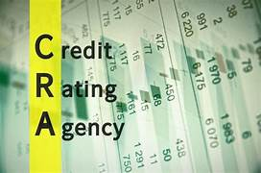

Slide 7
Some key roles of credit rating agencies:
Credit Assessment: The primary role of credit rating agencies is to assess the creditworthiness of entities, such as individuals, companies, and governments. They evaluate various factors such as financial statements, historical performance, industry trends, and economic conditions to determine the creditworthiness and likelihood of default.
Credit Ratings: Credit rating agencies assign credit ratings to borrowers and financial instruments based on their assessment. These ratings provide an opinion on the credit risk associated with the entity or instrument, helping investors and lenders make informed decisions. The ratings typically follow a standardized scale, allowing market participants to compare the creditworthiness of different entities or instruments.
Risk Mitigation: Credit ratings help investors and lenders mitigate risks by providing an independent assessment of credit quality. By relying on credit ratings, investors can diversify their portfolios and manage exposure to credit risk. Lenders can use credit ratings to set interest rates and terms for loans, considering the creditworthiness of borrowers.
Market Transparency: Credit rating agencies enhance market transparency by providing standardized and easily understandable information about credit risk. Their ratings enable investors and lenders to compare and assess the credit quality of various entities and instruments, facilitating efficient capital allocation and pricing in financial markets.
Regulatory Compliance: Credit rating agencies play a role in regulatory frameworks by providing information for regulatory compliance purposes. Regulatory bodies may rely on credit ratings to determine capital requirements for banks and financial institutions, assess the risk exposure of investment portfolios, and establish eligibility criteria for certain investments.
Investor Confidence: Credit rating agencies help build investor confidence by providing independent and credible assessments of creditworthiness. Investors often consider credit ratings as a reliable source of information when making investment decisions. The presence of credit ratings can enhance market liquidity and attract a broader range of investors.

Slide 8
Major Credit Rating Agencies

Slide 9
Credit Rating Methodologies
Credit rating methodologies are frameworks used by credit rating agencies to assess the creditworthiness of entities such as corporations, governments, or securities. These methodologies provide a systematic approach to evaluating the credit risk associated with an entity or financial instrument.

Slide 10
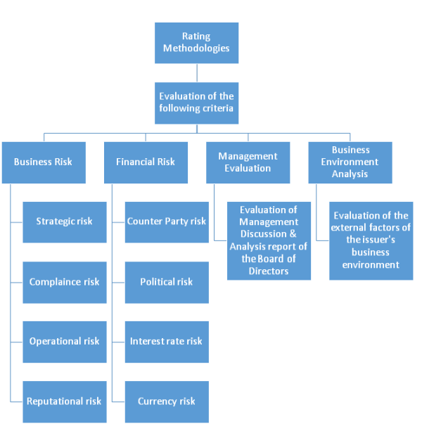
Diagrammatic representation of credit methodology

Slide 11
While different rating agencies may have their own proprietary methodologies, the general principles and factors considered in credit rating methodologies include:
Financial Ratios and Metrics: Rating agencies analyze various financial indicators such as leverage ratios, liquidity ratios, profitability measures, and cash flow metrics. These help assess an entity's ability to meet its financial obligations and manage its debt.
Industry and Competitive Analysis: The rating agencies consider the characteristics and dynamics of the industry in which the entity operates. Factors such as market competition, regulatory environment, and industry trends can impact the creditworthiness of an entity.
Business and Operating Risk: The agencies evaluate an entity's business model, management quality, competitive position, and operating environment. They assess factors such as market demand, technological changes, and competitive advantages to understand the potential risks to the entity's financial health.
Governance and Management: The creditworthiness of an entity is influenced by the effectiveness of its governance structure, management team, and risk management practices. Rating agencies assess the quality of corporate governance, board independence, and strategic decision-making.

Slide 12
Cash Flow Analysis: Evaluating an entity's ability to generate sufficient cash flow to meet its debt obligations is crucial. Rating agencies examine cash flow projections, revenue stability, working capital management, and the ability to withstand adverse economic conditions.
Debt Structure and Covenants: The structure of an entity's debt, including maturity profile, interest rate exposure, and debt covenants, is considered. Rating agencies assess the potential impact of debt repayment obligations and restrictions on financial flexibility.
Country Risk (for sovereign ratings): When rating governments or sovereign entities, rating agencies also consider factors such as political stability, economic policies, fiscal strength, and external vulnerabilities.
It's important to note that different rating agencies may emphasize certain factors more than others and may have their own unique methodologies. However, these general principles provide an overview of the key considerations in credit rating methodologies.

Slide 13
Credit Rating Criteria
Financial History and Stability
Creditworthiness
Debt Service Coverage
Credit History
Industry and Economic Factors:
External Factors

Slide 14
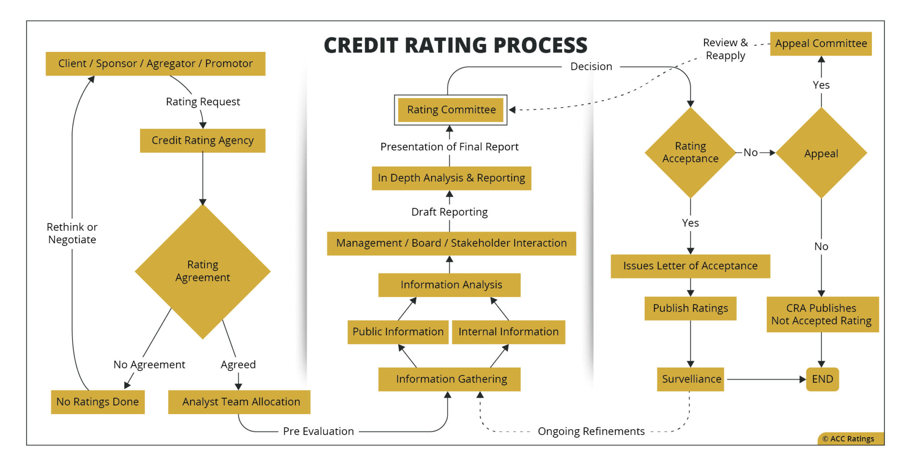

Slide 16
The credit rating of a company is a measure of its creditworthiness and is influenced by various factors. While specific methodologies and criteria used by credit rating agencies may vary, here are some common factors that can affect a company's credit rating:
Financial Performance: The financial performance of a company is a significant factor in determining its credit rating. Key financial indicators such as revenue growth, profitability, cash flow, and debt levels are considered. A company with consistent and strong financial performance is more likely to have a higher credit rating.
Debt Levels and Leverage: The amount of debt a company carries and its leverage ratio (debt-to-equity ratio) are crucial considerations. High levels of debt or excessive leverage can increase the risk associated with the company's ability to meet its debt obligations, potentially leading to a lower credit rating.
Industry and Competitive Position: The industry in which a company operates plays a role in determining its credit rating. Industries with stable and predictable cash flows, low competition, and strong market positions are generally viewed favorably. Conversely, companies in volatile or highly competitive industries may face greater risks and have lower credit ratings.

Slide 17
Business Diversification: The diversification of a company's business lines and customer base is important. A well-diversified company is less vulnerable to disruptions in specific markets or customer segments. This diversification can contribute to a higher credit rating.
Management Quality and Corporate Governance: The quality and competence of a company's management team and its corporate governance practices are assessed. Strong leadership, transparent financial reporting, and effective risk management strategies are factors that can positively impact a company's credit rating.
Economic Environment: The overall economic conditions and macroeconomic factors, such as GDP growth, interest rates, inflation, and industry trends, can influence a company's credit rating. Economic downturns or adverse market conditions may lead to a lower credit rating.
Legal and Regulatory Environment: Compliance with applicable laws and regulations is crucial. Companies operating in highly regulated sectors or facing legal challenges may experience credit rating downgrades if their ability to meet obligations is compromised.
Market Perception and Investor Confidence: Credit rating agencies also consider market perception and investor confidence in a company. Factors such as reputation, brand strength, and investor sentiment can impact credit ratings.

Slide 18
Internal Credit Rating…
Internal Credit Risk Rating System refers to the system to analyze a borrower's repayment ability based on information about a customer's financial condition including its liquidity, cash flow, profitability, debt profile, market indicators, industry and operational background, management capabilities, and other
Under the Basel II guidelines, banks are allowed to use their own estimated risk parameters for the purpose of calculating regulatory capital. This is known as the internal ratings-based approach to capital requirements for credit risk

Slide 19
External Credit Rating…
In the case of external credit ratings, agencies are hired by the respective issuer to evaluate the creditworthiness by analyzing the qualitative and quantitative information of the issuer. ... Both credit ratings mirror the likelihood of a full payment of an issuer in a certain time frame.

Slide 20
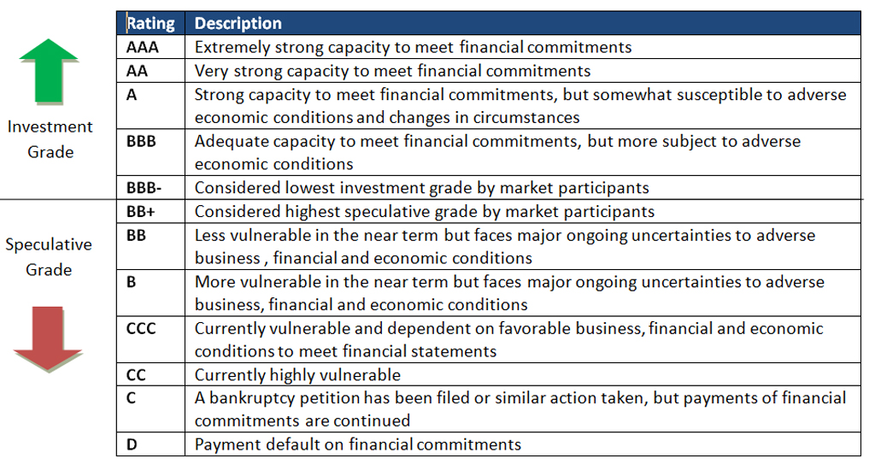
Credit Rating Descriptions

Slide 21
Credit Rating Agency Vs. Credit Information Company
Parameter | Credit Rating Agency | Credit Information Company
Opinion | Opinion on future debt repayment capability in timely manner | Information on the fulfilment of the past debt obligations of the borrower
Relevance to Lender | Relevant for investment in instrument of institution & corporate | Relevant for extending loans to borrowers, including individuals
Under 4C model | Shows capacity to repay | Shows character to repay
Example | CRISIL, Care, Moody's, Fitch etc | CIBIL, Equifax, Crif

Slide 22
Case study on credit rating going wrong
How Indian credit raters missed an epic fail at a financier
IL&FS Group is a vast conglomerate with a complex corporate structure that funds infrastructure projects across the world’s fastest-growing major economy. The financier, set up in 1987, and its listed subsidiaries have powered India’s infrastructure boom-- including the Chenani-Nashri road tunnel, India’s longest--and raised billions of dollars from the country’s corporate debt market.
In July, company founder Ravi Parthasarathy stepped down, citing health reasons. In August a default within the group rattled India’s money markets, added to pressure on corporate bond yields and sparked a sell-off in the stock market. The Reserve Bank of India has initiated a special audit, given the potential systemic risk the group poses to other non-bank lenders and worries about $500 million of repayment obligations coming due over the next six months.
The nation’s credit rating industry has come under scrutiny after the firms that assessed IL&FS, including the local partners of Moody’s Investors Service and Fitch Ratings, failed to see the financial troubles brewing at the financier. The group’s debt burden jumped 44 percent in the year ended March 31 from 2015.
"

Slide 23
Case study on credit rating going wrong---continued
Great Unraveling The Indian credit rating companies’ failure to foresee the great unraveling at IL&FS has left Prime Minister Narendra Modi’s top economic policymakers, including Reserve Bank of India Governor Urjit Patel and Finance Minister Arun Jaitley, facing contagion risk to the broader financial sector.
“There is definitely a case for revisiting ratings standards and the whole rating framework,” Rajiv Kumar, India’s banking secretary said in an interview. “Some kind of accountability needs to be there. It has to be made more robust.” IL&FS is a huge borrower, accounting for 2 percent of outstanding commercial paper, 1 percent of debentures and as much as 0.7 percent of banking system loans. The group itself in turn acts as a key source of capital to non-bank lenders. Another worry is is a stampede by individual investors out of fixed-income mutual funds that will force portfolio managers to sell other companies’ debt securities to cover redemption requests, setting off a vicious cycle.

Slide 24
Case study on credit rating going wrong----IL& FS Group
The burning question now is whether credit analysts should have seen the financial reckoning at the IL&FS group earlier. It was no secret that funding costs for companies in India surged as the interest rates in the nation’s credit markets hit multi-year highs. For IL&FS, short-term debt increased 30 percent to 135.6 billion rupees ($1.9 billion) in the year to March 31, according the company’s annual report.

Slide 25
THANK YOU

