Slide 1
Session-2
Credit Rating- Part-2

Slide 2
Table of Contents
Role of Credit rating in Business Development
Intricacies of Financial Statement during Credit Rating
History of Fitch
History of Moody’s Investor Services
History of Standard & Poor
Alternate to Credit Rating
Risk Associated with Credit Rating
Important Ratios for Credit Rating
Rating Rationale of Infosys

Slide 3
Role of Credit Rating in Business Development
1.Access to Financing:
Credit rating affects a company's ability to secure loans, credit lines, or other forms of financing. Lenders and investors often rely on credit ratings to assess the creditworthiness and risk profile of a business. A higher credit rating indicates a lower risk of default, making it easier and more affordable for a company to obtain funding for expansion, capital investments, or working capital.
2. Cost of Capital:
A good credit rating can lead to lower interest rates and better terms on loans, bonds, or other financial instruments. This, in turn, reduces the cost of capital for the business, enabling it to invest in growth opportunities, research and development, or new market entry. Conversely, a lower credit rating may result in higher borrowing costs, limiting the company's financial flexibility.
3. Supplier and Customer Relationships:
Credit rating also influences the trust and confidence that suppliers and customers have in a business. A strong credit rating demonstrates financial stability and reliability, making it easier to negotiate favorable terms with suppliers, such as longer payment terms or bulk purchase discounts. Additionally, a good credit rating reassures customers about the company's ability to fulfill orders and meet contractual obligations.

Slide 4
4. Business Partnerships and Alliances:
When establishing partnerships or alliances with other companies, credit rating can serve as an indicator of financial health and integrity. A favorable credit rating enhances the reputation of the business and makes it more attractive as a potential partner, opening up opportunities for joint ventures, collaborations, or strategic alliances.
5. Investor Confidence:
Credit rating plays a significant role in attracting investors and maintaining investor confidence. Institutional investors, such as pension funds or mutual funds, often have specific credit rating requirements for their investment portfolios. A higher credit rating can increase the attractiveness of a company's stocks or bonds to potential investors, leading to a broader investor base and improved liquidity in the financial markets.
6. Risk Management and Decision Making:
Credit rating helps businesses assess the creditworthiness of their own customers and suppliers. By evaluating the credit ratings of counterparties, businesses can make informed decisions about extending credit, setting payment terms, managing trade credit risk, and maintaining a healthy cash flow.

Slide 5
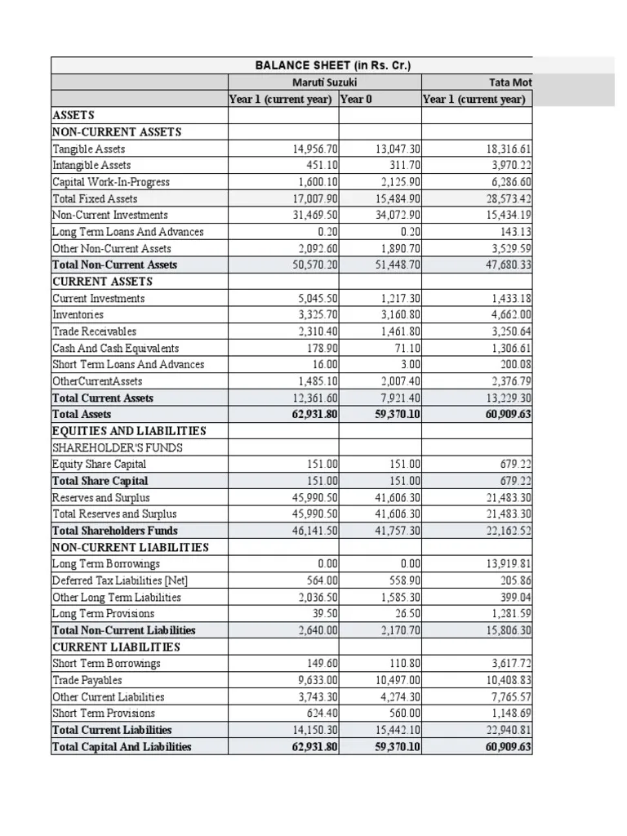
Intricacies of Financial Statement during Credit Rating
During the process of credit rating, financial statements play a crucial role in assessing the creditworthiness of a company or entity. Credit rating agencies analyze various aspects of financial statements to evaluate the entity's ability to meet its financial obligations. Here are some key intricacies of financial statements that are considered during credit rating:
Balance Sheet: The balance sheet provides a snapshot of the entity's financial position at a specific point in time. Credit rating agencies examine the composition and quality of assets, including liquidity and diversification. They also assess the entity's capital structure, looking at the level of debt, equity, and leverage. Furthermore, the balance sheet helps determine the entity's solvency and its ability to repay debt obligations.

Slide 6
Cash Flow Statement: The cash flow statement shows the entity's cash inflows and outflows during a specific period. Credit rating agencies closely examine the cash flow from operating activities to assess the entity's ability to generate cash internally. They also evaluate the cash flow from investing and financing activities to understand the entity's investment decisions, capital structure, and external financing sources.
Financial Ratios: Credit rating agencies calculate and compare various financial ratios derived from the financial statements. These ratios include liquidity ratios (e.g., current ratio, quick ratio), profitability ratios (e.g., gross margin, operating margin), and leverage ratios (e.g., debt-to-equity ratio, interest coverage ratio). Ratios provide insights into the entity's financial health, performance, and risk profile.
Quality of Financial Reporting: Credit rating agencies assess the quality and transparency of the entity's financial reporting practices. They look for adherence to accounting standards, consistency in accounting policies, and the presence of any unusual or aggressive accounting practices. High-quality financial reporting enhances the reliability of financial statements and facilitates accurate credit analysis.
Industry Comparisons: Credit rating agencies benchmark the entity's financial statements against its industry peers. They consider industry-specific factors, trends, and risks to evaluate the company's competitive position and relative performance. Industry comparisons provide context for assessing the entity's financial strength and creditworthiness within its sector.

Slide 7
HISTORY OF FITCH
Fitch Ratings, commonly known as Fitch, is one of the "Big Three" credit rating agencies, along with Standard & Poor's and Moody's. It is a global provider of credit ratings, research, and analysis services. Fitch's ratings are widely used by investors, issuers, and regulators to assess the creditworthiness of companies, governments, and securities.
Here's a brief history of Fitch:
Foundation and Early Years:
Fitch Ratings was founded in 1913 by John Knowles Fitch, a 33-year-old engineer and investor.
The company initially focused on providing investors with information about railroad bonds and other fixed-income securities.
Fitch's approach to credit analysis involved visiting companies, interviewing management, and assessing financial statements.
Fitch Ratings:
In 2000, Fitch IBCA changed its name to Fitch Ratings, aligning its brand more closely with its core business.
The company expanded its operations globally, opening offices in various financial centers around the world.

Slide 8
Regulatory Challenges and Reforms:
The global financial crisis of 2008 led to increased scrutiny of credit rating agencies and calls for regulatory reforms.
Fitch Ratings, along with other rating agencies, faced criticism for their role in the crisis and their ratings of mortgage-backed securities.
Since then, various regulatory reforms have been implemented to enhance transparency and accountability in the credit rating industry.
Today, Fitch Ratings remains a prominent player in the credit rating industry, providing credit opinions on a wide range of entities and financial instruments worldwide. Its ratings and analysis are considered essential tools for investors and market participants in assessing credit risk.

Slide 9
HISTORY OF MOODY’S INVESTOR SERVICES
Moody's Investor Services, commonly referred to as Moody's, is one of the world's leading credit rating agencies. It provides credit ratings, research, and risk analysis for companies, governments, and securities. Moody's is known for its ratings of bonds and other fixed-income instruments.
Here's a brief history of Moody's:
Foundation and Early Years:
Moody's was founded in 1909 by John Moody, an American financial analyst and investor.
John Moody published "Moody's Manual of Industrial and Miscellaneous Securities," a comprehensive guidebook that provided investors with information on various securities.
The manual included Moody's own credit ratings for railroad and industrial bonds.
Financial Crisis and Regulatory Reforms:
The global financial crisis of 2008 raised questions about the role and performance of credit rating agencies.
Moody's, along with other rating agencies, faced scrutiny for their ratings of complex financial instruments, such as mortgage-backed securities.
The crisis led to increased regulatory oversight and reforms aimed at improving transparency and accountability in the credit rating industry.

Slide 10
Today, Moody's Investors Service continues to be a major player in the credit rating industry. Its ratings and analysis are widely used by investors, issuers, and regulators to evaluate credit risk. Moody's has expanded its coverage to include sovereign ratings, corporate bonds, structured finance, and other financial instruments. The company operates globally, with offices in numerous countries, providing credit opinions and research across a wide range of sectors and geographies.

Slide 11
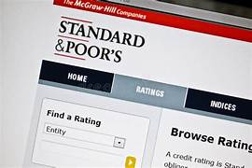
Standard & Poor, history…
Henry Varnum Poor first published the "History of Railroads and Canals in the United States" in 1860, the forerunner of securities analysis and reporting to be developed over the next century. Standard Statistics formed in 1906, which published corporate bond, sovereign debt, and municipal bond ratings. Standard Statistics merged with Poor's Publishing in 1941 to form Standard and Poor's Corporation, which was acquired by The McGraw-Hill Companies, Inc. in 1966. Standard and Poor's has become best known by indexes such as the S&P 500, a stock market index that is both a tool for investor analysis and decision-making and a U.S. economic indicator.

Slide 12
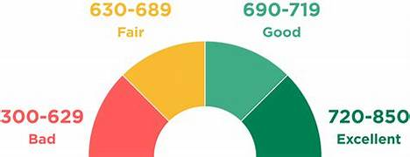
ALTERNATE TO CREDIT RATING

Slide 13
An alternative to traditional credit ratings is the concept of alternative credit scoring. While credit ratings primarily rely on an individual's credit history and financial information, alternative credit scoring takes into account additional factors and data sources to assess creditworthiness. Here are a few examples of alternative credit scoring methods:
Alternative Data: Instead of relying solely on traditional credit data, alternative credit scoring incorporates non-traditional data sources such as utility bill payments, rental history, mobile phone payments, and even social media activity. By analyzing these alternative data points, lenders can gain a more comprehensive view of an individual's creditworthiness.
Machine Learning Algorithms: Advanced machine learning algorithms can be employed to analyze large volumes of data and identify patterns that traditional credit rating models might overlook. These algorithms can process a wide range of variables and factors to generate credit scores, including employment history, educational background, spending habits, and more.

Slide 14
Bank Account Analysis: Some alternative credit scoring models consider an individual's bank account transactions and balance history. By evaluating income stability, cash flow, and responsible financial behavior, these models provide a more nuanced assessment of creditworthiness.
Peer-to-Peer Assessments: Peer-to-peer lending platforms often use alternative credit scoring methods that involve community feedback and assessments. Borrowers are evaluated based on their relationships within the platform, their reputation, and reviews from other users. This approach allows individuals with limited credit history to access loans based on the trust and endorsement of their peers.
Collateral-Based Assessments: Instead of solely relying on credit history, lenders may assess creditworthiness based on collateral provided by the borrower. This could include assets such as property, vehicles, or other valuable possessions. If the borrower defaults on the loan, the lender has the right to seize and sell the collateral to recover the funds.
These alternative credit scoring methods aim to provide a more inclusive and comprehensive evaluation of creditworthiness, especially for individuals who may have limited credit histories or operate outside the traditional financial system. However, it's important to note that these methods are still evolving, and their effectiveness and adoption may vary in different regions and industries.

Slide 15
Risks associated with Credit Rating…
Biasness
Quality of rating
Confusion between rating of an instrument and rating of the company
Industry/Sector specific affect on rating
Qualitative aspects differs with different rating agency
Rating agency can not quickly foresee worsening credit condition
Rating Agency can not predict future risk

Slide 16
Important ratios for Credit Rating
Credit rating agencies assess the creditworthiness of individuals, companies, and governments based on various factors. While the specific ratios considered may vary among rating agencies, here are some important ratios commonly used in credit rating analysis:
Debt-to-Equity Ratio
Interest Coverage Ratio
Current Ratio
Debt Service Coverage Ratio (DSCR)
Profitability Ratios
Cash Flow to Debt Ratio
It's important to note that credit rating agencies use a combination of quantitative and qualitative factors to determine credit ratings. The specific weightage assigned to each ratio may vary among agencies and depend on the industry or sector being assessed. Additionally, other factors, such as market conditions, industry trends, and management quality, are also considered in credit rating analyses.

Slide 17
Rating Rationale

Slide 18
THANK YOU

