Slide 1
Session-3
Credit Rating

Slide 2
Table of Contents
Standard Risk rating for any Business
Key Factors Affecting Rating of Banks
Key Factors Affecting Rating of Insurance Company
Method of Credit Rating of Insurance Companies
Macro Economic factors affecting Credit Rating
Micro Economic factor affecting Credit Rating
Basel Norms
CAMELS Rating

Slide 3
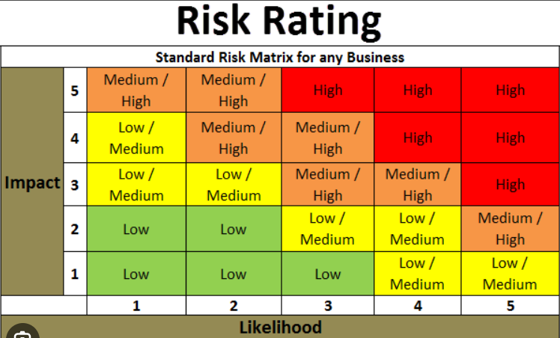

Slide 4
Key factors- Rating of Banks
Capital Adequacy
Liquidity
Management Quality
Asset Quality
Earning & Profitability

Slide 5
Capital adequacy is a crucial aspect of a bank's financial health and stability. It refers to the bank's ability to absorb losses and maintain solvency by having sufficient capital reserves relative to its risk exposure.
Tier-1 Capital:
It represents the highest-quality capital and serves as the core measure of a bank's capital strength. CET1 capital includes common shares, retained earnings, and other comprehensive income. It provides the most significant loss-absorbing capacity for the bank.
2. Tier-2 Capital:
Tier 2 capital consists of instruments such as subordinated debt and loan loss reserves that provide additional loss-absorbing capacity.

Slide 6
Asset quality is a critical aspect of a bank's financial health and stability. It refers to the quality and performance of a bank's loan portfolio and other assets. A bank with high asset quality has a lower risk of loan defaults, non-performing assets (NPAs), and credit losses.
Here are key aspects considered when evaluating asset quality:
NPA
Provisions
Credit Risk Assessment Quality
Concentration of Portfolio
Collateral and security
Delinquency Rates
Asset Classification
Stress Testing

Slide 7
Earnings and profitability are crucial indicators of a bank's financial health and performance. They reflect the bank's ability to generate income, cover expenses, and provide returns to shareholders. When evaluating the earnings and profitability of a bank, several key aspects are considered:
Net Interest Income (NII): Net interest income is the difference between a bank's interest income from loans and investments and its interest expenses on deposits and borrowings.
Net Interest Margin (NIM): Net interest margin represents the percentage of net interest income relative to a bank's interest-earning assets.
Non Interest Income: Non-interest income includes fees and commissions, trading income, wealth management fees, and other sources of revenue apart from interest income.
Operating Expense: Operating expenses include personnel costs, overhead expenses, technology investments, and other costs associated with running the bank
Return on Asset (ROA): ROA measures the profitability of a bank relative to its total assets. It indicates how effectively a bank utilizes its assets to generate profits.
Return on Equity (ROE): ROE measures the profitability of a bank in relation to its shareholders' equity.
Efficiency Ratio: The efficiency ratio compares a bank's operating expenses to its net revenue. It reflects the bank's ability to manage costs and generate income. A lower efficiency ratio indicates better cost control and operational efficiency.
8. Provision for Loan Loss: Banks set aside provisions to cover potential losses from loan defaults. A prudent and forward-looking approach to provisioning helps protect profitability by adequately covering credit risk.

Slide 8
Liquidity is a crucial aspect of a bank's financial strength and stability. It refers to the ability of a bank to meet its short-term obligations and fund its operations without incurring excessive costs or disruptions
Here are key aspects considered when evaluating the liquidity of a bank:
1. Cash Position: The level of cash and cash equivalents held by a bank is an essential indicator of its liquidity.
2. Liquid Assets: Besides cash, liquid assets such as marketable securities and highly liquid investments are crucial for liquidity management.
3. Funding Source: Banks rely on various funding sources to support their operations. These include customer deposits, interbank borrowings, and access to capital markets
4. Liquidity Coverage Ratio: The LCR is a regulatory requirement that measures a bank's ability to withstand a short-term liquidity stress scenario
5. Loan to Deposit Ratio: The LDR represents the proportion of a bank's loans relative to its customer deposits.
6.Central Bank Facilities: Banks often have access to central bank facilities, such as discount windows or standing facilities, to borrow funds during times of liquidity stress.
7.Stress Testing: Banks conduct stress tests to assess their liquidity position under adverse scenarios,
8. Regulatory Requirements: Regulatory authorities impose liquidity requirements to ensure banks maintain an adequate level of liquidity

Slide 9
Management quality plays a crucial role in the overall performance, stability, and success of a bank.
When evaluating management quality in a bank, several key aspects are considered:
Leadership & Vision
Experience & Expertise
Risk Management
Corporate Governance
Talent management & succession
Ethical Standards & Integrity
Performance & Results
Adaptability & Innovation

Slide 10
Key factors- Rating of Insurance Company
Financial Statement Analysis
Risk Management
Regulatory Compliance
Capital Adequacy Assessment
Investment Portfolio Analysis
Peer to peer comparison

Slide 11
Financial statement analysis is a crucial tool for evaluating the financial performance, stability, and solvency of insurance companies.
Here are key aspects to consider when conducting financial statement analysis for an insurance company
Revenue & Premium Growth: Overall Revenue and Premium and percentage growth
Investment Income: Income earned from various investment
Claims ratio to loss reserve: Insurance companies set aside reserves to cover potential claims and policyholder obligations. Analyze the claims ratio, which compares claims paid to premiums earned, to assess the company's underwriting profitability and claims management. Evaluate the adequacy of loss reserves by comparing them to historical claims experience and industry benchmarks.
Expense Ratio: The expense ratio measures the operating expenses incurred by the insurance company as a percentage of premiums earned.
Combined Ratio: The combined ratio is the sum of the claims ratio and the expense ratio.
Solvency & Capital Adequacy: Evaluate the insurance company's capital adequacy and solvency position by analyzing its capital structure, risk-based capital ratios, and regulatory requirements.
Return on Equity: ROE measures the profitability of the insurance company relative to its shareholders' equity.
Cash Flow Analysis: Assess the statement of cash flows to evaluate the company's cash generation, cash flows from operations, investing activities, and financing activities.
Regulatory Disclosures: Review the company's regulatory filings and disclosures, including annual reports and financial statements, to gain insights into the company's operations, risk management practices, and regulatory compliance.

Slide 12
Capital adequacy is a critical measure of the financial strength and solvency of an insurance company.
Here are key aspects to consider when evaluating the capital adequacy of an insurance company:
Risk Based Capital: Regulatory authorities establish risk-based capital frameworks that define the minimum capital requirements based on the company's risk profile and business activities. Insurance companies must maintain capital levels above these regulatory thresholds.
Solvency margin: The solvency margin is the excess of an insurance company's available assets over its liabilities
Capital Structure: Analyze the insurance company's capital structure, including the mix of equity, retained earnings, and debt.
Risk Assessment & Risk based capital allocation: Insurance companies face various risks, including underwriting risk, investment risk, credit risk, and operational risk. Evaluate the company's risk assessment and management practices. Analyze the allocation of capital based on the risk profile of different lines of business, products, and investments.
Stress Test: Insurance companies conduct stress tests to assess the impact of adverse scenarios on their capital position.
Reinsurance: Assess the company's reinsurance arrangements, including the quality and reliability of reinsurers, to understand how reinsurance coverage contributes to the company's capital adequacy.
Regulatory Compliance: Insurance companies must comply with regulatory requirements related to capital adequacy.

Slide 13
Investment portfolio analysis is a critical process for insurance companies to evaluate the performance, risk, and composition of their investment portfolios.
Here are key aspects to consider when conducting investment portfolio analysis for an insurance company:
Asset Allocation
Diversification
Investment performance
Risk Assessment
Investment Selection & Due Diligence
Portfolio turnover
Investment guidelines & constraints
ESG factors
Reporting & Communication

Slide 14
Risk management is a fundamental process for insurance companies to identify, assess, mitigate, and monitor risks that could impact their financial stability, profitability, and ability to meet policyholder obligations
Here are key components and practices of risk management for insurance companies:
Risk Identification
Risk Assessment & measurement
Risk Mitigation & Control
Underwriting & Pricing discipline
Investment Risk Management
Reinsurance and Risk transfer
Operational Risk Management
Risk Monitoring & Reporting
Regulatory Compliance
Risk Culture & Governance

Slide 15
Regulatory compliance is a critical aspect of operating an insurance company.
Here are key areas of regulatory compliance for insurance companies:
Licensing & Registration
Capital Adequacy
Solvency & Reserves
Underwriting & Pricing
Market Conduct & Consumer Protection
Investment Regulation
Anti Money Laundering
Data Privacy and security
Financial reporting & disclosures
Regulatory reporting and compliance monitoring

Slide 16
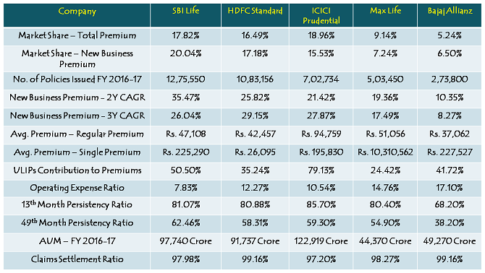
Peer to Peer Comparison of Insurance Companies

Slide 17
Macro Economic factors affecting rating

Slide 19
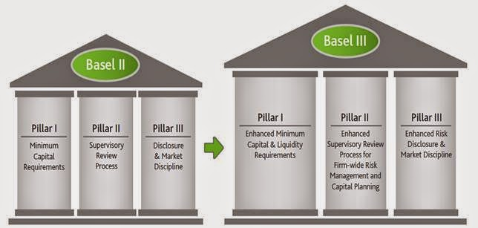

Slide 20
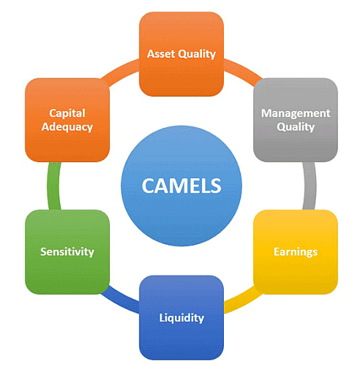

Slide 21
THANK YOU

